Slide 1

Dra. Rosmery Duran Ubiera. Ph.D.

Slide 2
Substance use Disorder
DSM V
12 Criteria.
Complex disease that involves the compulsive use of substances, such as alcohol, opioids and other drugs. Individuals continue using these substances despite experiencing negative impact to their life.
DSM IV
Abuse.
Dependence.
Substance use disorder impairs the function of different organs and systems in the body, including the immune system.

Slide 3

Statistics

Slide 4
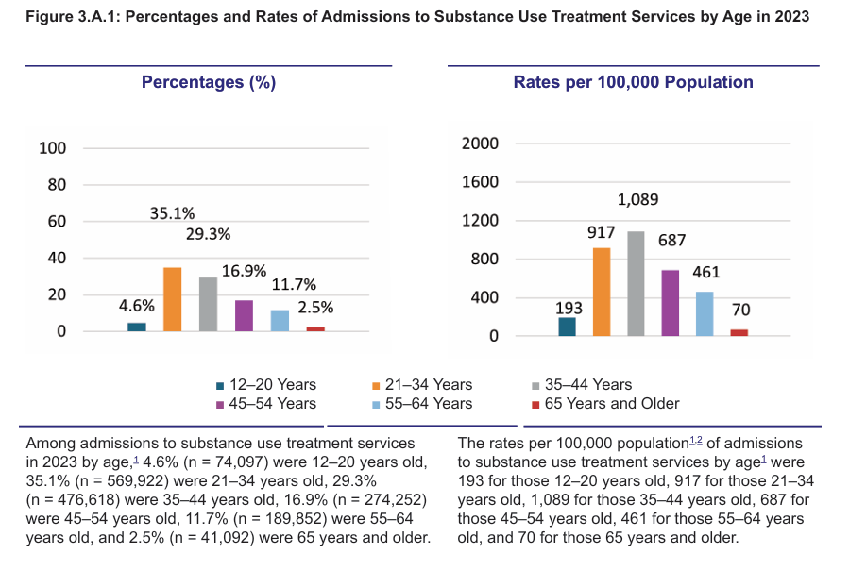
Characteristics of Admissions to Substance Use Treatment Services, 2023.
Substance Abuse and Mental Health Services Administration: Treatment Episode Data Set (TEDS) 2023: Admissions to and Discharges from Substance Use Treatment Services Reported by Single State Agencies. Publication No. PEP25-07-014, Substance Abuse and Mental Health Services Administration, 2025.

Slide 5
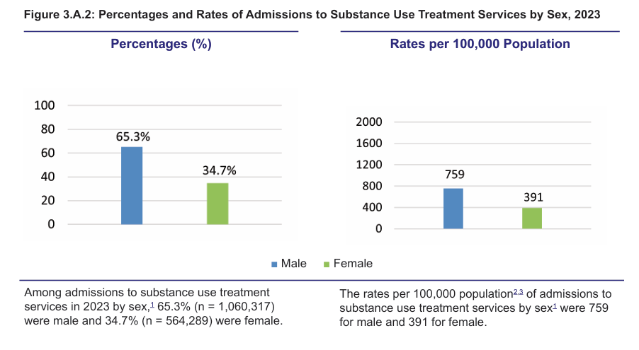
Substance Abuse and Mental Health Services Administration: Treatment Episode Data Set (TEDS) 2023: Admissions to and Discharges from Substance Use Treatment Services Reported by Single State Agencies. Publication No. PEP25-07-014, Substance Abuse and Mental Health Services Administration, 2025.

Slide 6
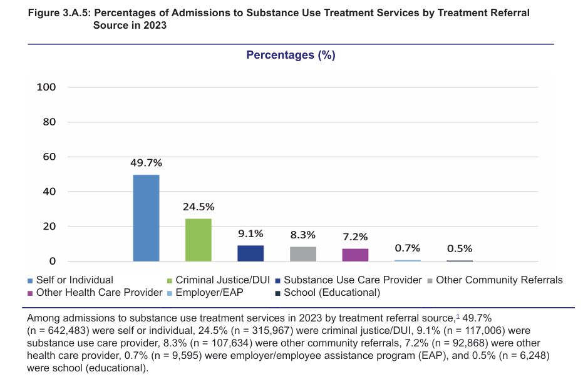
Substance Abuse and Mental Health Services Administration: Treatment Episode Data Set (TEDS) 2023: Admissions to and Discharges from Substance Use Treatment Services Reported by Single State Agencies. Publication No. PEP25-07-014, Substance Abuse and Mental Health Services Administration, 2025.

Slide 7
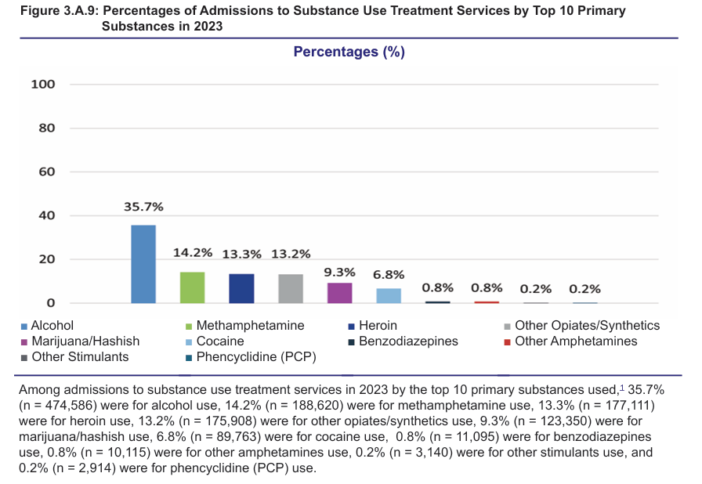
Substance Abuse and Mental Health Services Administration: Treatment Episode Data Set (TEDS) 2023: Admissions to and Discharges from Substance Use Treatment Services Reported by Single State Agencies. Publication No. PEP25-07-014, Substance Abuse and Mental Health Services Administration, 2025.

Slide 8
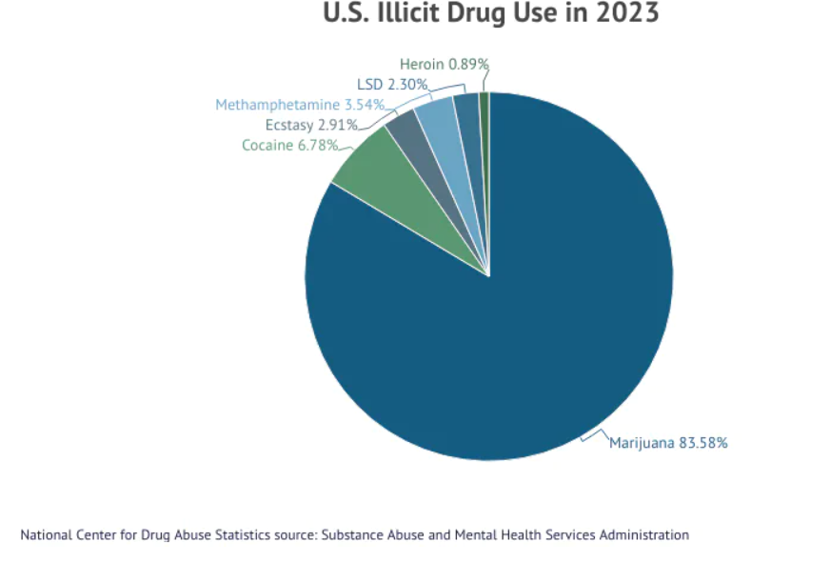

Slide 9
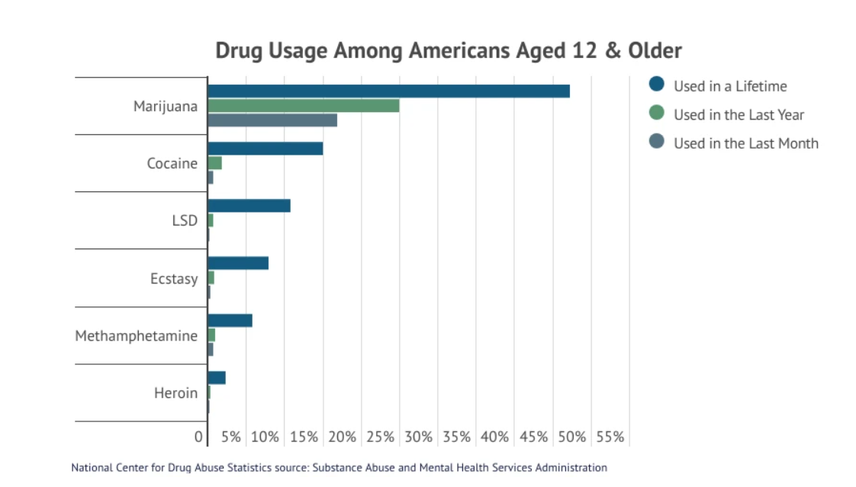

Slide 10
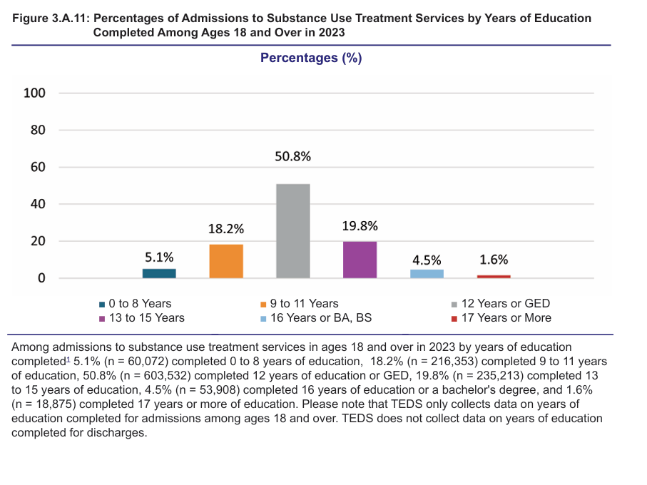
Substance Abuse and Mental Health Services Administration: Treatment Episode Data Set (TEDS) 2023: Admissions to and Discharges from Substance Use Treatment Services Reported by Single State Agencies. Publication No. PEP25-07-014, Substance Abuse and Mental Health Services Administration, 2025.

Slide 11
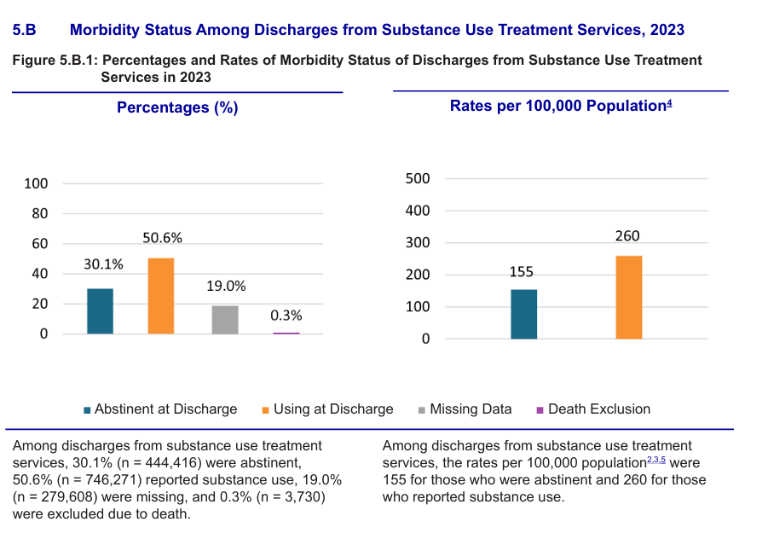
Substance Abuse and Mental Health Services Administration: Treatment Episode Data Set (TEDS) 2023: Admissions to and Discharges from Substance Use Treatment Services Reported by Single State Agencies. Publication No. PEP25-07-014, Substance Abuse and Mental Health Services Administration, 2025.

Slide 12
51.2%
Over half of people 12 and older have used illicit drugs at least once.
1.15M
Drug overdoses have killed over 1 million people in the U.S. alone since 1999.
$44.5B
The federal budget for drug control in 2024 was nearly $45 billion.
National Center for
Drug Abuse Statistics

Slide 13
Immune System
The immune system has been classically seen as the body defense against infections, but is more than that, is a complex system that integrating cells, organs and secreting substances participate in maintaining the body homeostasis at different levels and participates of different processes as wound healing.
The immune system is affected by substance use disorder and the impact is closely linked to the substance involved.
When the Immune System is compromised opportunistic infections find the perfect scenario to appear.

Slide 14
Opportunistic Infections/Diseases
Infections that are harmless in healthy individuals but detrimental in immunocompromised individuals.
Examples:
Tuberculosis
Salmonella
Pneumocystis Carini
candidiasis

Slide 15
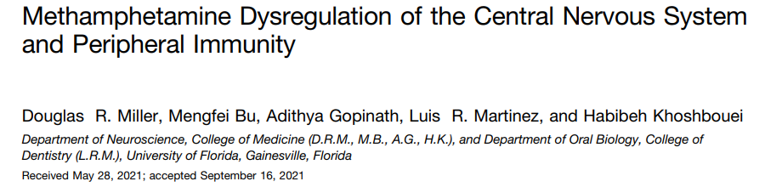
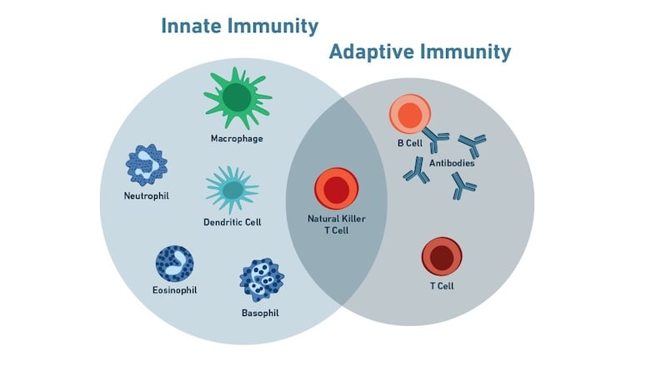
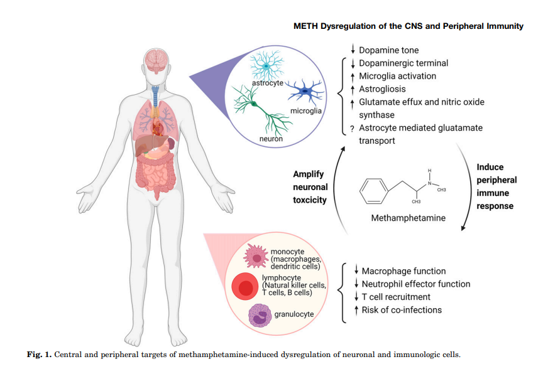
Methamphetamines and Immune system
Fount: https://blog.cellsignal.com/immunology-overview-how-does-our-immune-system-protect-us.

Slide 16
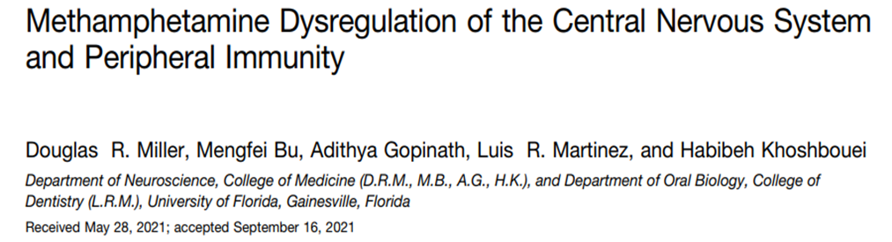

Slide 17
Opioids
The opioids are a family of drugs utilized in the treatment of pain, which interact with the opioid receptors. The opioids can be natural, semisynthetic and synthetic. Some of the members of this family are widely used in a compulsive manner because of their effects in Central Nervous system, the activation of opioids receptors lead to an increase production of dopamine in the brain.
Opioids addictive capacity varies from one to another being oxycodone the one of the most popular opioids.
Poppy Papaver Somniferum- Morphine

Slide 18
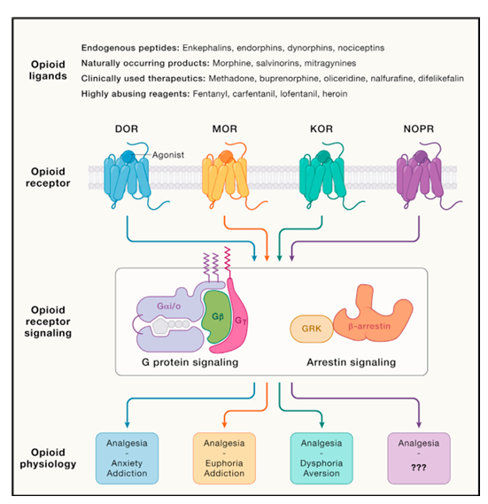
Opioid Receptors
Fount: Tao Che, and Bryan L. Roth Cell 189, 2023

Slide 19
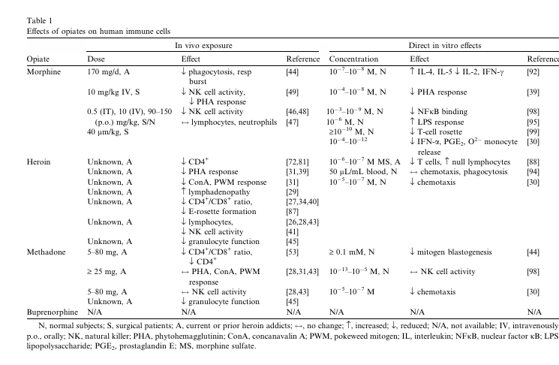

Slide 20
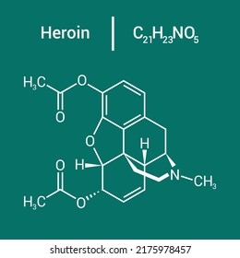
Heroin
Illegal, highly addictive drug processed from morphine, a naturally occurring substance extracted from the seed pod of certain varieties of poppy plants. It is typically sold as a white or brownish powder that is “cut” with sugars, starch, powdered milk, or quinine.
Fount: NIH

Slide 21
Heroin and HIV

Slide 23
Cocaine
Derived from the Erythroxylon Coca Shrub that grows in the foothills of the Andes Mountain in South America.
Inhibits the reuptake of norepinephrine into the adrenergic neuron.
Inhibits the reuptake of dopamine and serotonin.

Slide 24
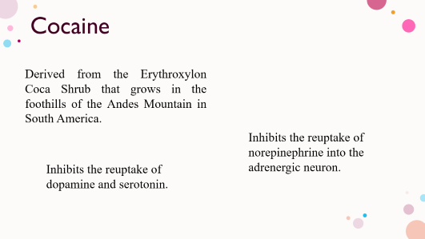
Cocaine and Immune system
Number and distribution of immune cells.
Thymus Weight.
CD8+ T Cells.
Agranulocytosis.
Also play a role:
Adulterants (Levamisole)
Monoamines
Alcohol= Cocaethylene

Slide 25
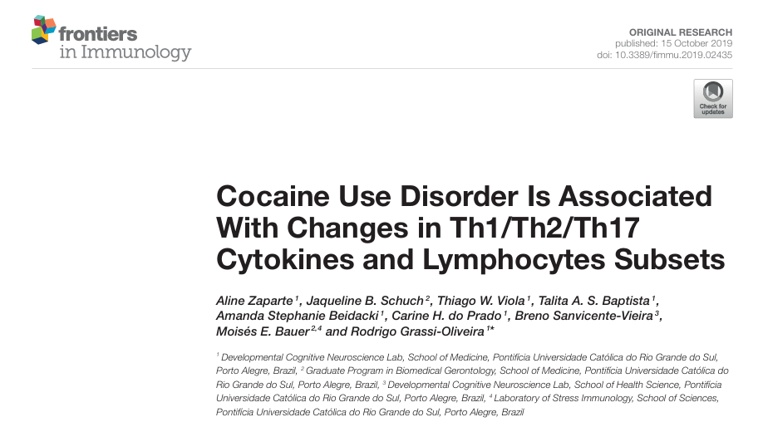
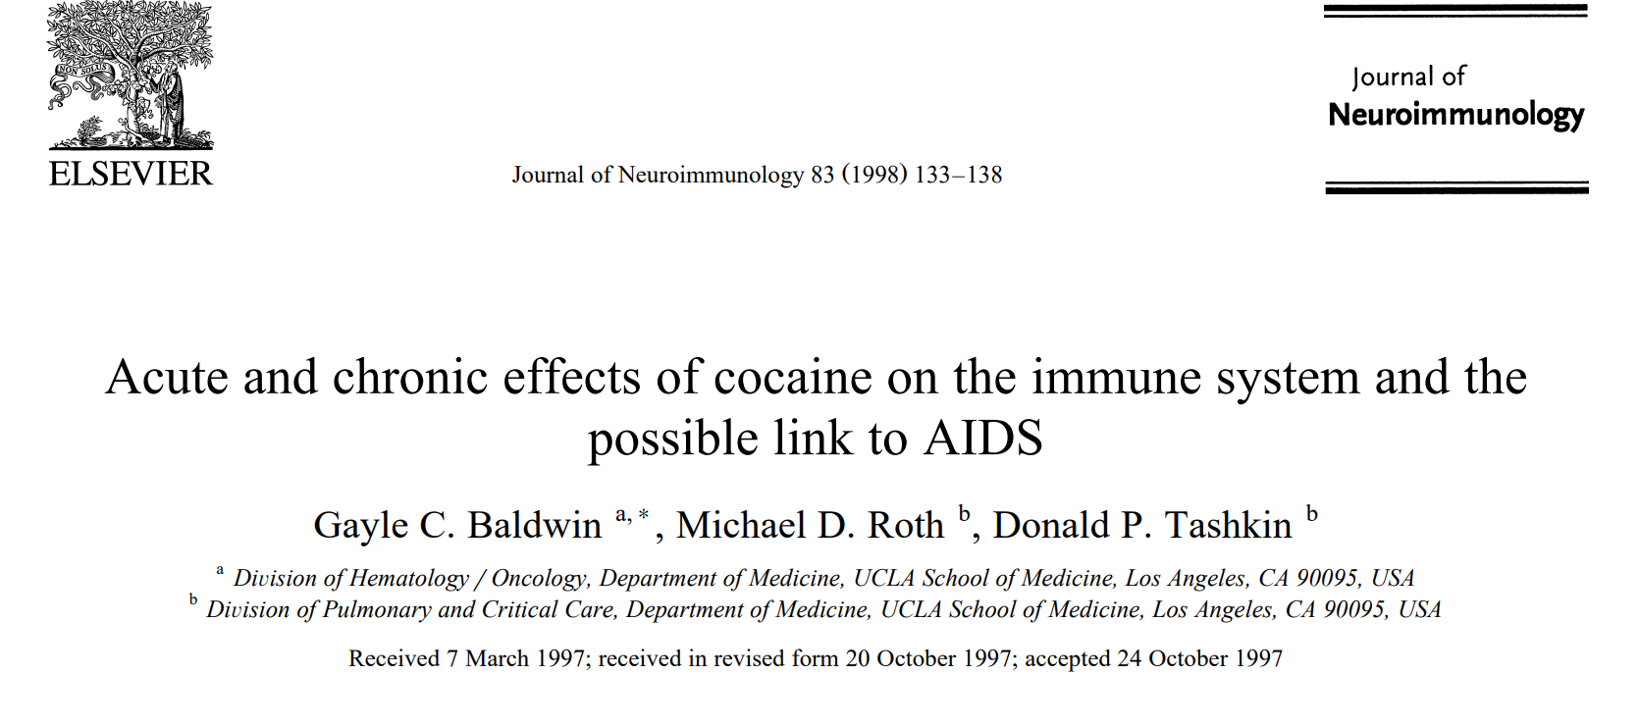

Slide 26
Cannabis
Cannabinoid Receptors:
CB1 (Brain).
CB2 (Periphery).
The most frequently used illicit drug and the one that new users are most likely to try.
The endogenous Cannabinoids forms the Endocannabinoid System (ECS).

Slide 27
Cannabinoids and Immune System.
CBD (Non-Psycho-active Cannabinoid)
Alter the functional activities of immune system.
Serves as Immune suppressor
Induces Apoptosis
Cannabis and its Cannabinoids:
Immune-modulating Agents
Affects T cells, B Cells, Monocytes and Microglia leading to overall reduction of proinflammatory cytokines expression.

Slide 28
Ethanol
Clear, colorless hydroxylated hydrocarbon that is the product of fermentation of fruits, grains or vegetables. Major cause of fatal automobile accidents and fatal falls. Alcohol is the most abused substance in modern society.
Reduce life expectancy by 10 to 15 years.

Slide 29
Ethanol Effects are exerted through the following mechanisms:
Enhance the effects of the Inhibitory neurotransmitter GABA.
Induce the release of endogenous Opioids.
Alters the levels of Serotonin and Dopamine.

Slide 30
Ethanol Effects are exerted through the following mechanisms:
Disruption of GI/ Respiratory track barriers.
Impairs phagocytic function of monocytes.
Enhance expression of CCR5 (Chemokine Receptor) in Macrophages.
Decrease the number of Dendritic Cells preventing the generation of a virus specific response.
Impairs the cytokine balance.

Slide 31
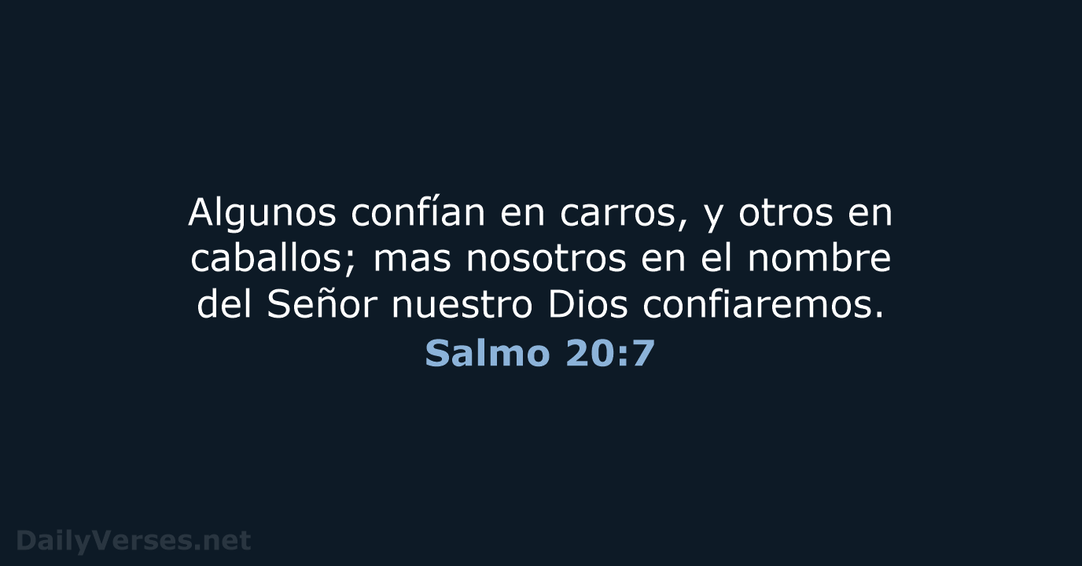
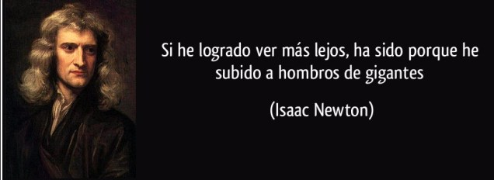
Thank you!

