Slide 1
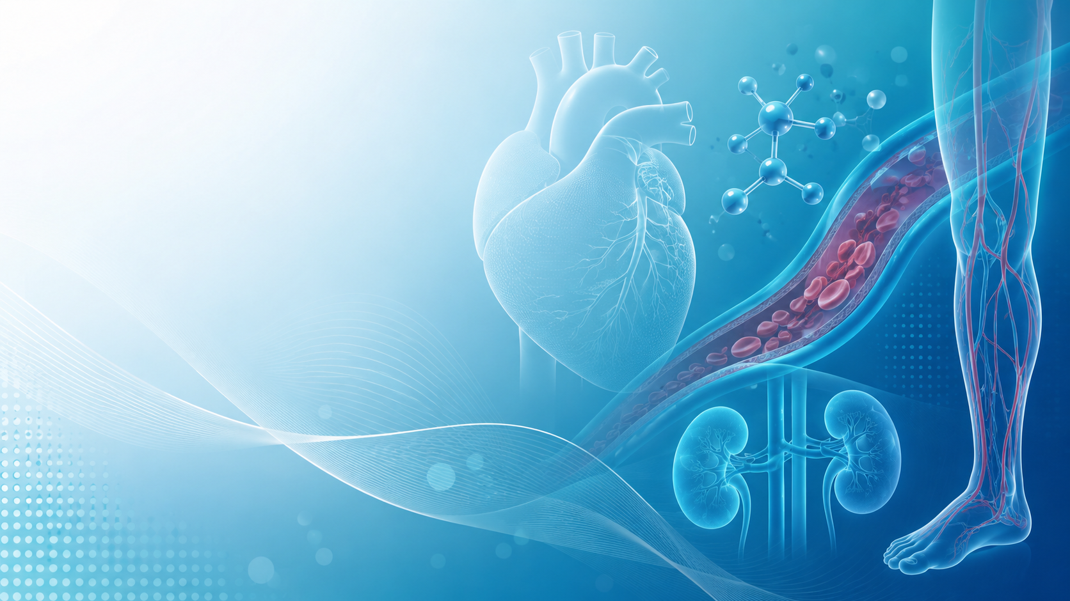
Beyond A1c
Diabetes & Cardiovascular Risk
A practical primary care approach
Dr. Eliscer Guzman, MD, FACC.

Slide 2
Why this matters: a high-burden cardiometabolic problem
40.1M
115.2M
919,032
805,000
people in the U.S. had diagnosed or undiagnosed diabetes in 2023
U.S. adults had prediabetes
CVD deaths in the U.S. in 2023 — about 1 in every 3 deaths
Heart attacks occur each year in the U.S.; about 1 in 5 are silent
115.2M
That is more people than the entire population of Germany, France,
or the United Kingdom.
CDC National Diabetes Statistics Report, 2026 | CDC Heart Disease Facts, 2024/2025

Slide 3
Why this topic matters
Diabetes is a cardiovascular disease accelerator—not just a glucose disorder.
Diabetes, Prediabetes & Cardiovascular Complications | Primary Care
2

Slide 4
Major Cardiovascular Complications of Diabetes
Data-driven view for primary care: diabetes is a systemic vascular disease, not only hyperglycemia.
>2×
>2x
2–4×
Coronary artery disease
Ischemic stroke / TIA
Heart failure
Higher incident CHD risk vs adults without diabetes; consider silent ischemia and atypical symptoms.
Diabetes is linked to ischemic stroke risk; hypertension and dyslipidemia further amplify risk.
Diabetes increases HF risk; HFpEF is common with obesity, HTN, and CKD.
[1]
[2]
[3]
2–7×
38%
+28%
Peripheral artery disease
CKD / cardiorenal syndrome
Atrial fibrillation
PAD is more prevalent in diabetes; neuropathy can mask claudication and rest pain.
≈4 in 10 adults with diabetes have CKD; screen with eGFR and urine ACR.
Diabetes increases AF risk; prediabetes also increases AF risk by ≈20%.
[4]
[5]
[6]
Primary care message: treat diabetes as a cardiometabolic disease — manage A1c, BP, LDL-C, kidney risk, weight, smoking, and vascular symptoms together.
Refs: [1] Kalyani RR. Heart Disease and Diabetes. NCBI Bookshelf, 2023. [2] Chen C. Stroke and Diabetes in Adults. NCBI Bookshelf, 2025. [3] Park JJ et al. Cardiovasc Diabetol, 2021. [4] Soyoye DO et al. World J Diabetes, 2021; ACC PAD Scientific Statement, 2025. [5] CDC CKD in the United States, 2026. [6] Aune D et al. Nutr Metab Cardiovasc Dis, 2018.
Diabetes, Prediabetes & Cardiovascular Complications | Primary Care
Updated data slide
Notes:
Speaker notes:
This slide emphasizes that diabetes is a systemic vascular disease. CAD risk is approximately doubled; ischemic stroke risk is substantially elevated; diabetes confers a two- to fourfold higher heart failure risk; PAD is markedly more prevalent and may be clinically silent because of neuropathy; CKD affects roughly 38% of U.S. adults with diabetes; and diabetes is associated with a 28% higher risk of atrial fibrillation. In primary care, the practical approach is to treat beyond A1c: blood pressure, LDL-C, kidney screening, weight, smoking, vascular symptoms, and medication selection with cardiorenal benefit.

Slide 5
The diabetes–cardiovascular duality
Prediabetes and diabetes are part of a cardiovascular–kidney–metabolic continuum.
CKM = Cardiovascular–Kidney–Metabolic syndrome: a framework linking obesity, prediabetes/diabetes, hypertension, dyslipidemia, CKD and CVD into one interconnected risk pathway.
Insulin resistance
metabolic stress
Prediabetes / obesity
early risk stage
HTN + dyslipidemia
vascular injury
CKD risk
albuminuria/eGFR
ASCVD / HF / PAD
clinical events
~90%
U.S. adults had CKM stage ≥1
At least one cardiometabolic risk factor: excess adiposity, metabolic risk, CKD or CVD.
Aggarwal et al., JAMA 2024
14.6%
Advanced CKM stages 3–4
Already high-risk: subclinical CVD risk or established cardiovascular disease.
Aggarwal et al., JAMA 2024
Beyond A1c
Primary care opportunity
Screen early and treat BP, LDL-C, weight, kidney function, albuminuria and vascular symptoms.
AHA Presidential Advisory 2023
Key takeaway: Diabetes care is cardiovascular prevention — start before the first event.
References: Ndumele CE et al. Circulation. 2023;148:1606–1635. Aggarwal R et al. JAMA. 2024;331:1858–1860.
Diabetes, Prediabetes & Cardiovascular Risk in Primary Care
6
Notes:
This slide introduces CKM syndrome as the organizing framework for diabetes and cardiovascular prevention. CKM stands for cardiovascular-kidney-metabolic syndrome. The key point is that risk starts before diabetes is formally diagnosed. NHANES 2011-2020 data showed almost 90% of U.S. adults met criteria for CKM stage 1 or higher, and 14.6% met criteria for advanced stages 3 or 4. In primary care, this means we should not wait for A1c to reach the diabetic range or for a cardiovascular event to happen. We should screen early for blood pressure, lipids, obesity, kidney function, albuminuria, smoking, PAD symptoms, and heart failure symptoms, and treat beyond A1c.

Slide 6
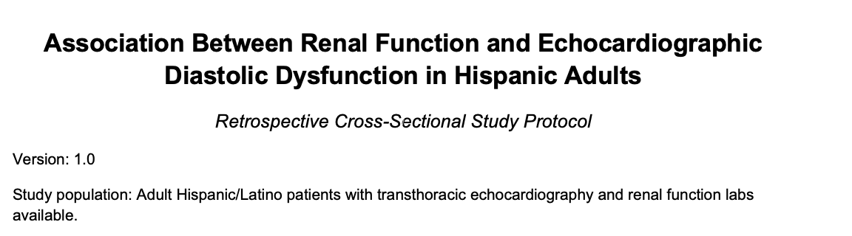
Renal signal
eGFR / UACR
Echo changes
LVDD markers
Pre-HF risk
HFpEF pathway
K
E
HF
1. Unmet clinical need
2. Hispanic/Latino relevance
3. Our research question
Silent cardiorenal disease
Subclinical LV dysfunction is common
Can renal labs flag early cardiac disease?
CKD is common and frequently unrecognized. CDC estimates 38% of U.S. adults with diabetes have CKD and 87% of adults with CKD are unaware.
In ECHO-SOL, 49.7% of Hispanic/Latino adults had LV systolic or diastolic dysfunction; 96.1% was subclinical or unrecognized.
We will test whether reduced eGFR and/or albuminuria are associated with echocardiographic diastolic dysfunction in Hispanic adults.
Clinical relevance:
If renal dysfunction tracks with diastolic dysfunction, routine eGFR/UACR could help identify patients needing earlier echo review, HFpEF prevention, and tighter CKM risk control.
Refs: CDC CKD in the United States, 2026; Mehta et al., Circ Heart Fail, 2016; Kuno et al., JACC Heart Fail, 2023; Matsushita et al., JAHA, 2017.
Diabetes, Prediabetes & Cardiovascular Risk in Primary Care
Study slide

Slide 7
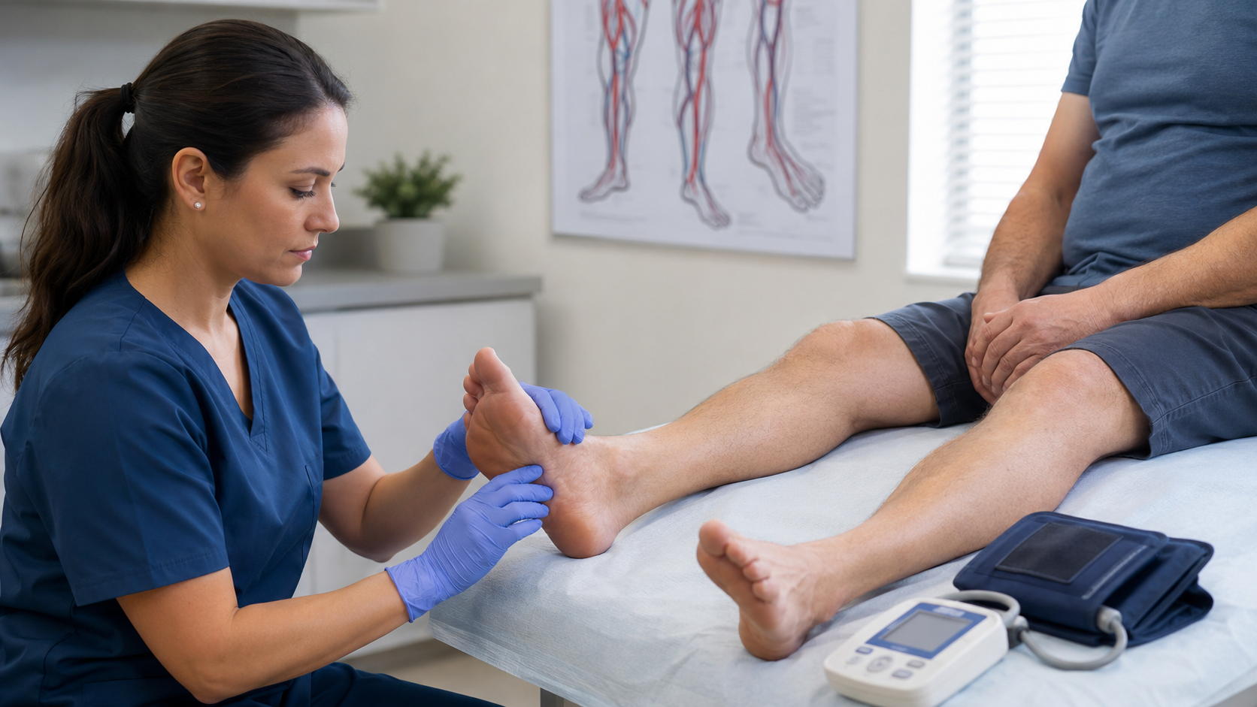
Peripheral Artery Disease in Diabetes
Common, silent, and high-risk — especially when neuropathy masks symptoms.
10–12M
~25%
U.S. adults live with PAD
Adults ≥65 with diabetes have PAD
A major ASCVD condition linked to MI, stroke, limb events, and death.
Diabetes accelerates atherosclerosis and increases limb risk.
Up to 40%
1.3%
PAD patients report no leg pain
U.S. adults have severe PAD / CLTI-level risk
Classic claudication is often absent; neuropathy can hide symptoms.
Tissue loss, amputation risk, and high mortality require urgent action.
Primary care action
Ask claudication, exertional leg fatigue, rest pain, cold feet, non-healing wounds.
Examine DP/PT pulses, skin, nails, ulcers, temperature.
Order ABI when symptoms/signs or high suspicion are present; refer urgently for rest pain or tissue loss.
References: 2024 ACC/AHA Multisociety PAD Guideline; ACC Scientific Statement on PAD in Adults With Diabetes, 2025; AHA PAD Health Disparities Statement, 2023.
Diabetes, Prediabetes & Cardiovascular Risk in Primary Care
1
Notes:
This slide should emphasize that PAD is a systemic atherosclerotic disease, not just a leg problem. In patients with diabetes, neuropathy may mask symptoms, so primary care clinicians should actively ask about exertional leg fatigue, rest pain, cold feet, wounds, and examine pulses and feet. ABI is the key low-cost diagnostic test when PAD is suspected. Urgent referral is needed for tissue loss, gangrene, rest pain, or non-healing wounds.

Slide 8
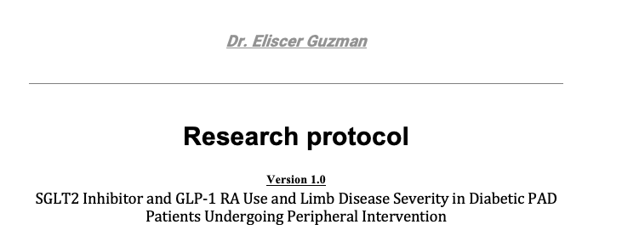
1. Unmet clinical need
2. Evolving therapy gap
3. Our research question
PAD in diabetes is often silent
Modern agents may matter
Severity at intervention
Neuropathy may mask claudication or rest pain. Many patients present only when ulcers, tissue loss, or advanced ischemia appear.
SGLT2 inhibitors and GLP-1 receptor agonists improve cardiovascular and kidney outcomes, but limb-specific PAD data remain heterogeneous.
Are users of SGLT2i or GLP-1 RA less likely to present with advanced PAD severity when they reach peripheral intervention?
Clinical relevance: If associated with less severe PAD presentation, earlier cardiometabolic optimization may help shift care from limb salvage to vascular prevention.
Refs: 2024 ACC/AHA PAD Guideline; Das et al., JACC 2025; Hong et al., Diabetes Res Clin Pract 2025; Caturano et al., J Clin Med 2025.

Slide 9
The primary-care cardiovascular risk checklist
This is the minimum dataset for a diabetes/prediabetes visit.
Glycemia
A1c, fasting glucose, meds, hypoglycemia
Weight
BMI, waist circumference, obesity treatment options
Blood pressure
Office BP + home BP when possible
ASCVD/HF symptoms
Chest pain equivalents, dyspnea, edema, exercise tolerance
Lipids
LDL-C, HDL-C, triglycerides, statin intensity
PAD/foot
Pulses, wounds, claudication, neuropathy
Kidney
eGFR + urine albumin/creatinine ratio
Lifestyle
Nutrition, activity, sleep, tobacco, alcohol
Clinical point: risk reduction comes from treating the cluster, not just lowering A1c.
ADA Standards of Care—2026: Comprehensive Medical Evaluation and Risk Management

Slide 10
Treatment framework: beyond A1c
Choose diabetes therapy by the patient's cardiovascular, kidney, weight, PAD risk — not only glucose level.
Risk-based treatment priorities
Key message
Before prescribing, ask:
Start with A1c,
but build the plan
around risk phenotype.
1
ASCVD or high CV risk?
BP control
LDL-C lowering
stroke, HF, CKD risk
ASCVD risk
2
Heart failure?
3
CKD or albuminuria?
SGLT2 inhibitor
GLP-1 RA / obesity tx
The medication choice should consider established ASCVD, heart failure, CKD, obesity, PAD, cost/access, and patient preference.
4
Obesity or weight goal?
HF / CKD benefit
ASCVD + weight benefit
5
PAD, smoking, or foot risk?
Smoking + PAD care
This makes diabetes care a CV–kidney–metabolic prevention strategy.
limb + ASCVD risk
Primary care action: screen eGFR + UACR, treat BP/LDL, address weight and smoking, and select SGLT2i/GLP-1 RA based on comorbid risk.
References: ADA Standards of Care in Diabetes—2026: Pharmacologic Approaches, Cardiovascular Disease & Risk Management, and CKD & Risk Management.
Diabetes, Prediabetes & Cardiovascular Risk in Primary Care
9

Slide 11
Prediabetes: cardiovascular risk is already active
Do not present it as “borderline sugar.” Present it as early vascular risk.
Core message
115.2M
>2 in 5
~80%
When A1c reaches 5.7–6.4%, the patient may already have insulin resistance, endothelial dysfunction, visceral adiposity, hypertension, dyslipidemia, fatty liver or kidney risk.
U.S. adults
adults
unaware
estimated to have prediabetes
meet criteria for prediabetes
most do not know they have it
Diagnostic range
A1c
FPG
2-hr OGTT
“This is the best time to prevent diabetes and cardiovascular disease.”
5.7–6.4%
100–125 mg/dL
140–199 mg/dL
Clinical takeaway: Prediabetes is already a cardiovascular-risk condition — screen and treat the whole cardiometabolic profile.
References: CDC National Diabetes Statistics Report 2026; ADA Standards of Care in Diabetes—2026, Section 3.
Diabetes, Prediabetes & Cardiovascular Risk in Primary Care

Slide 12
MESA Study: prediabetes risk can already be seen in the arteries
Coronary calcium shows subclinical atherosclerosis before symptoms or events.
MESA studied adults free of clinical CVD and used coronary artery calcium (CAC) on CT to detect silent atherosclerosis.
Impaired fasting glucose / MetS
Incident CAC
CAC progression
CHD events
1.7×
1.9×
+22.6
HR 4.1–4.9
incident CAC
incident CAC
CAC progression
CHD events
Point for primary care: prediabetes often travels with metabolic syndrome. MESA shows this risk can already be seen as coronary calcium before symptoms appear.
References: Bild et al., Am J Epidemiol 2002; Wong et al., JACC Cardiovasc Imaging 2012; ADA Standards of Care in Diabetes—2026.
Diabetes, Prediabetes & Cardiovascular Risk in Primary Care

Slide 13
Evidence-based medications: headline cardiovascular data
EMPA-REG OUTCOME
DAPA-HF
SELECT
Dapagliflozin in HFrEF, with/without diabetes
Empagliflozin in T2D + high CV risk
Semaglutide 2.4 mg in overweight/obesity + established CVD, no diabetes
26% relative reduction in worsening HF or CV death
20% relative reduction in 3-point MACE
38% relative reduction in CV death
Zinman et al., NEJM 2015
McMurray et al., NEJM 2019
Lincoff et al., NEJM 2023
Zinman et al. NEJM 2015 | McMurray et al. NEJM 2019 | Lincoff et al. NEJM 2023 | ADA Standards of Care—2026

Slide 14
Prediabetes: lifestyle is a cardiovascular intervention
Lifestyle treatment prevents diabetes and improves cardiometabolic risk.
58%
5–7%
150 min/wk
reduction in diabetes incidence with intensive lifestyle intervention in the DPP
weight-loss goal used in diabetes prevention programs
moderate-intensity physical activity target
Primary-care counseling script
“Your A1c is in the prediabetes range. This is not diabetes yet, but it is a strong warning sign. Our goal is to prevent diabetes and protect your heart, kidneys, brain and legs.”
Diabetes Prevention Program Research Group. NEJM 2002 | ADA Standards of Care—2026: Prevention or Delay of Diabetes

Slide 15
Lipids in Diabetes: Treat Early, Treat to Target
LDL-C lowering is cardiovascular prevention — not just cholesterol management.
<70 mg/dL
<55 mg/dL
4–12 wks
Primary prevention target
Secondary prevention target
Recheck after changes
Adults 40–75 with diabetes: treat LDL-C to target.
Diabetes + established ASCVD: intensify to lower LDL-C goal.
Repeat lipid panel after starting or changing lipid-lowering therapy.
Primary care action plan
1. Check lipid panel at diagnosis and at least annually.
2. Start statin based on age, ASCVD, and risk enhancers.
3. Escalate if LDL-C remains above goal: ezetimibe → PCSK9 pathway when appropriate.
LDL-C is not “just a lab value.”
In diabetes, it is a modifiable driver of MI, stroke, PAD, and limb events.
Treat diabetes as ASCVD prevention — act before the first event.
References: ADA Standards of Care in Diabetes—2026; ADA Lipid Management in Diabetes visual guide, 2026; 2026 ACC/AHA Dyslipidemia Guideline.
Diabetes, Prediabetes & Cardiovascular Complications | Primary Care
15

Slide 16
Lifestyle is cardiovascular medicine
Weight
Target clinically meaningful weight loss; even 5–10% can improve metabolic risk.
Activity
Aim for 150 min/week moderate activity + resistance training when feasible.
Nutrition
Mediterranean/DASH-style pattern; reduce sugary drinks and refined carbs.
Smoking
Ask, advise, assist; smoking strongly worsens ASCVD and PAD risk.
Sleep/stress
Screen for sleep apnea when obesity, resistant HTN, snoring, or daytime fatigue.
Adherence
Cost, insurance, side effects, and health literacy are clinical risk factors.
Diabetes, Prediabetes & Cardiovascular Complications | Primary Care
17

Slide 17
A practical algorithm for primary care
Use this workflow for every adult with prediabetes or diabetes.
Choose smart
meds
1
2
3
4
5
Treat the cluster
Refer early
Identify
Stage risk
A1c/FPG/OGTT + risk factors
ASCVD, HF, CKD, PAD, obesity
BP, LDL-C, weight, tobacco, glucose
SGLT2i / GLP-1 RA when phenotype fits
Symptoms, CKD progression, PAD wounds/rest pain
The “A1c-only” visit misses cardiovascular prevention opportunities.
ADA Standards of Care—2026 | AHA/ACC Primary Prevention and PAD guidance

Slide 18
When to refer
Cardiology
Chest pain, dyspnea/anginal equivalent, HF symptoms, abnormal ECG with symptoms, resistant HTN, established ASCVD.
Vascular / wound care
Rest pain, non-healing wound, absent pulses, abnormal ABI, suspected CLTI, gangrene, infection.
Nephrology
Rapid eGFR decline, severe albuminuria, advanced CKD, difficult BP control.
Endocrinology
Unclear diabetes type, recurrent hypoglycemia, complex insulin regimen, uncontrolled A1c.
Referral should not replace prevention.
Primary care should start risk reduction while specialty evaluation is pending.
Diabetes, Prediabetes & Cardiovascular Complications | Primary Care
18

Slide 19
Take-home messages
Prediabetes is a cardiovascular warning sign—not a benign label.
Diabetes is a cardiometabolic disease, not only hyperglycemia.
Primary care should screen for CAD, HF, CKD, and PAD symptoms.
Treat BP, LDL-C, weight, smoking, kidney disease, and glucose together.
Choose SGLT2 inhibitors / GLP-1 RAs when heart, kidney, obesity, and ASCVD risk support their use.
Early referral can prevent MI, stroke, heart failure, kidney failure, and amputation.
Diabetes, Prediabetes & Cardiovascular Complications | Primary Care
21

Slide 20
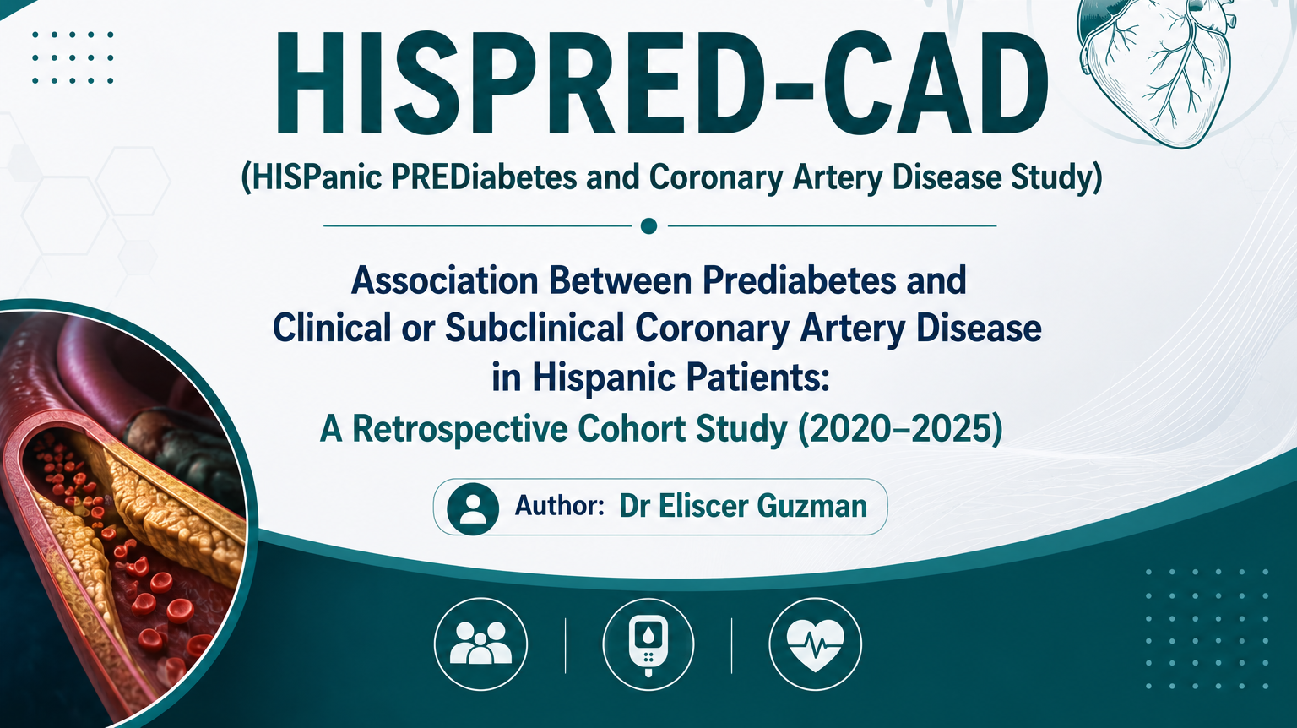

Slide 21
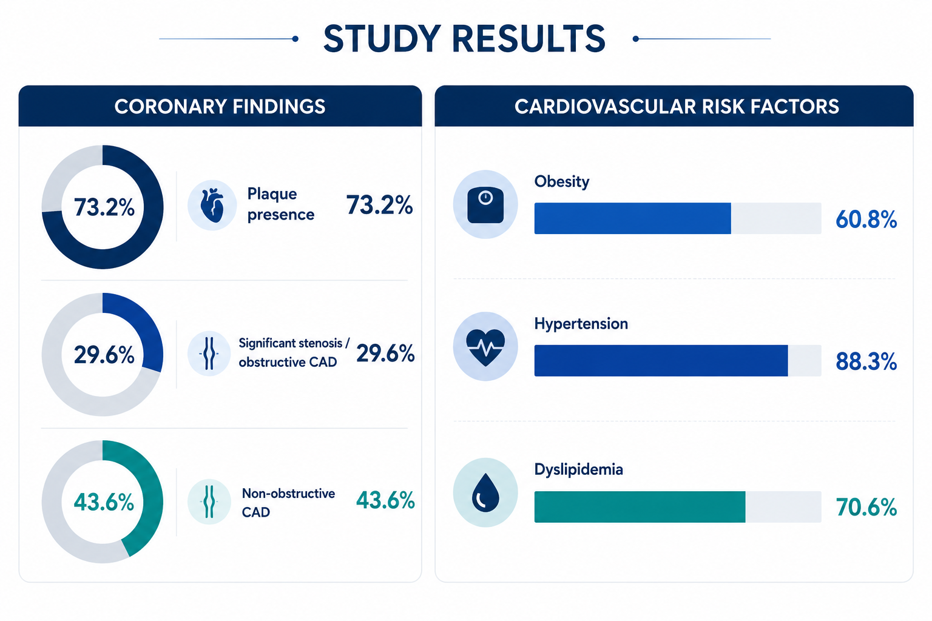

Slide 22
Selected references
• American Diabetes Association Professional Practice Committee. Standards of Care in Diabetes—2026. Diabetes Care. 2026;49(Suppl 1).
• Cardiovascular Disease and Risk Management: Standards of Care in Diabetes—2026. Diabetes Care. 2026;49(Suppl 1):S216–S245.
• Prevention or Delay of Diabetes and Associated Comorbidities: Standards of Care in Diabetes—2026. Diabetes Care. 2026;49(Suppl 1):S50–S60.
• Chronic Kidney Disease and Risk Management: Standards of Care in Diabetes—2026. Diabetes Care. 2026;49(Suppl 1):S246–S276.
• Das SR, Bonaca MP, Creager MA, et al. Management of Peripheral Artery Disease in Adults With Diabetes: 2025 ACC Scientific Statement. J Am Coll Cardiol. 2025. doi:10.1016/j.jacc.2025.11.027.
Diabetes, Prediabetes & Cardiovascular Complications | Primary Care
22

