Slide 1

Immunologic Diseases and Cardiovascular Risk
Beyond Traditional Risk Factors
Nicole S. De Leon, MD
Non-invasive Cardiologist
XX Annual International Multidisciplinary Medical Congress
Hispanic Health Professionals Association, Inc. — New York
May 24, 2026

Slide 2
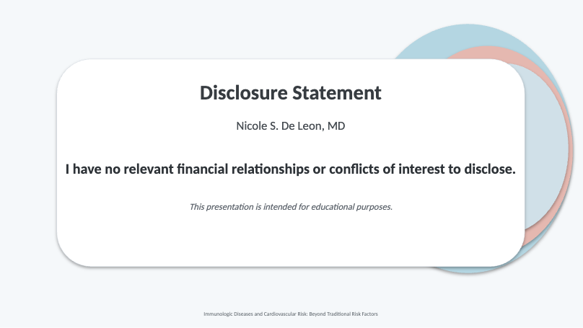

Slide 3
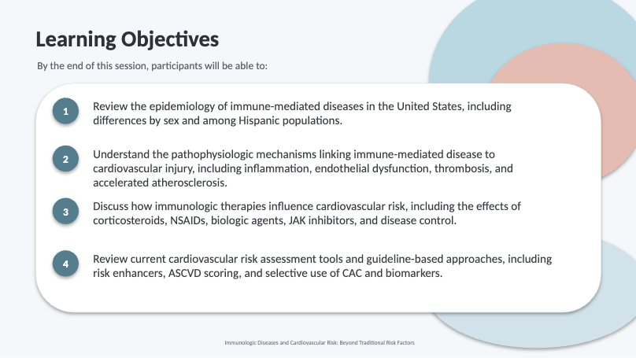

Slide 4
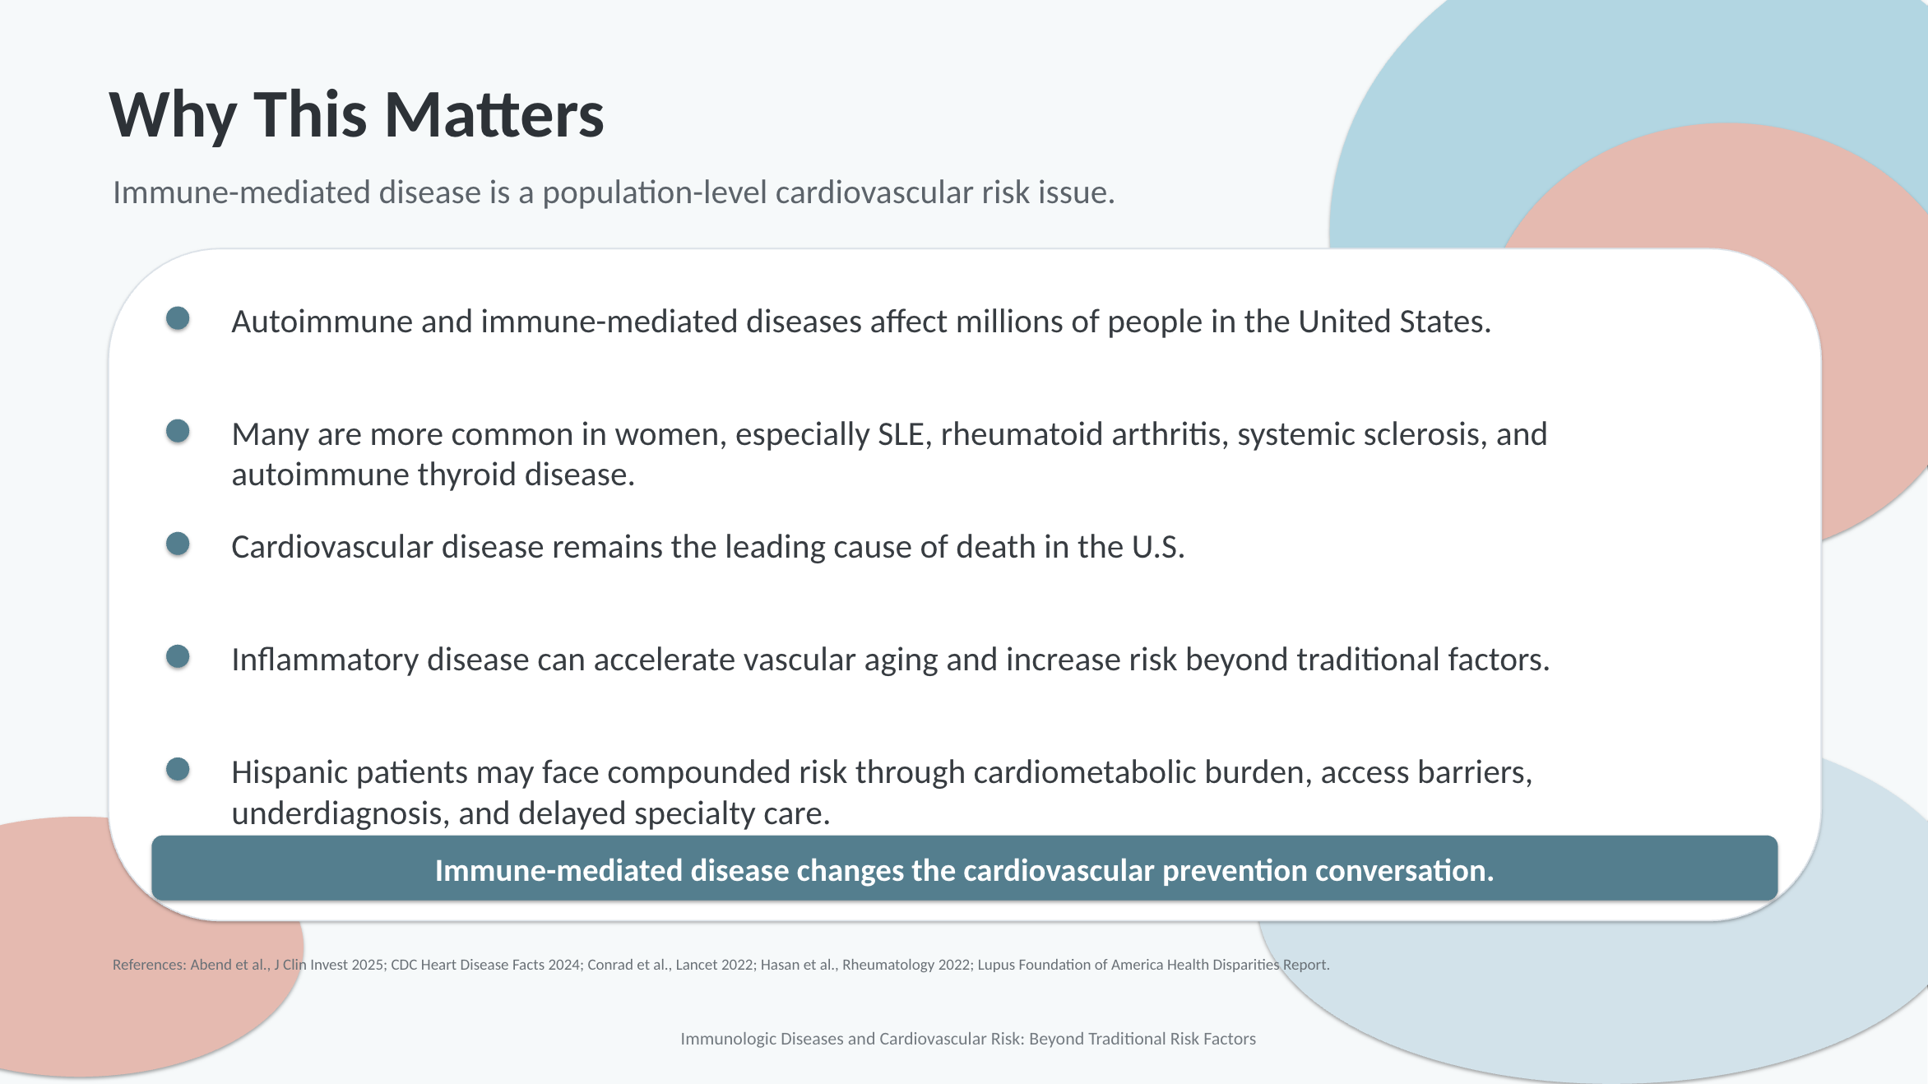

Slide 5

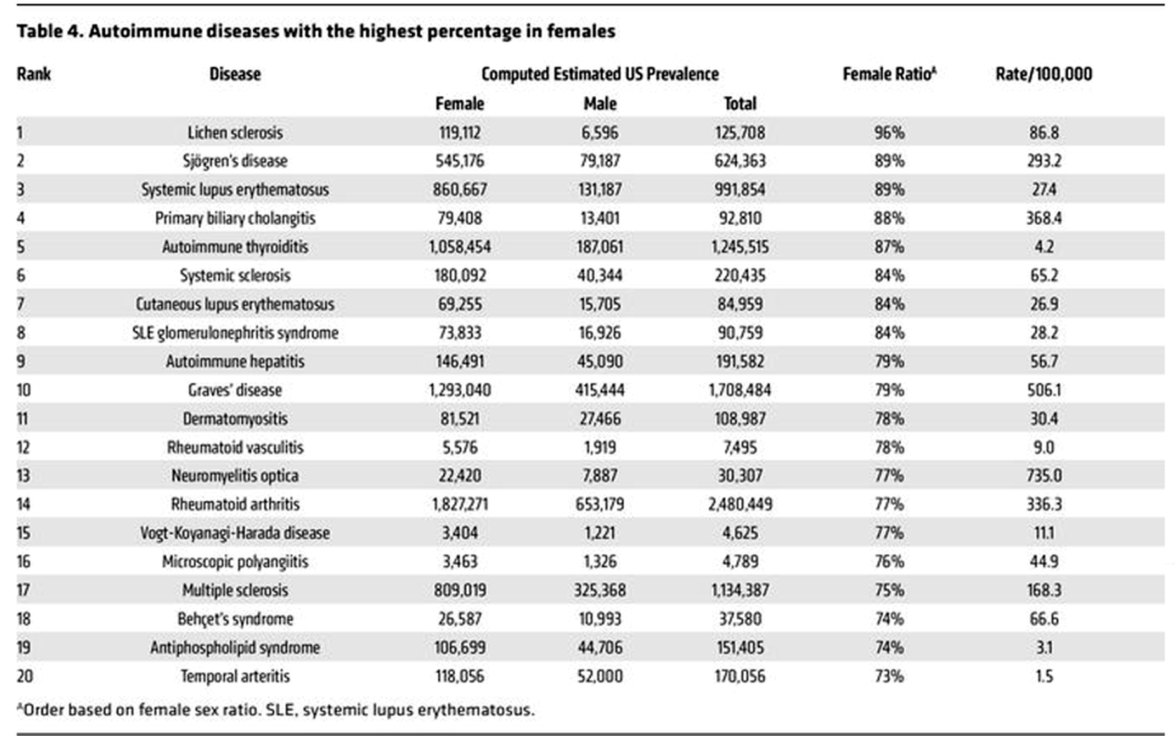
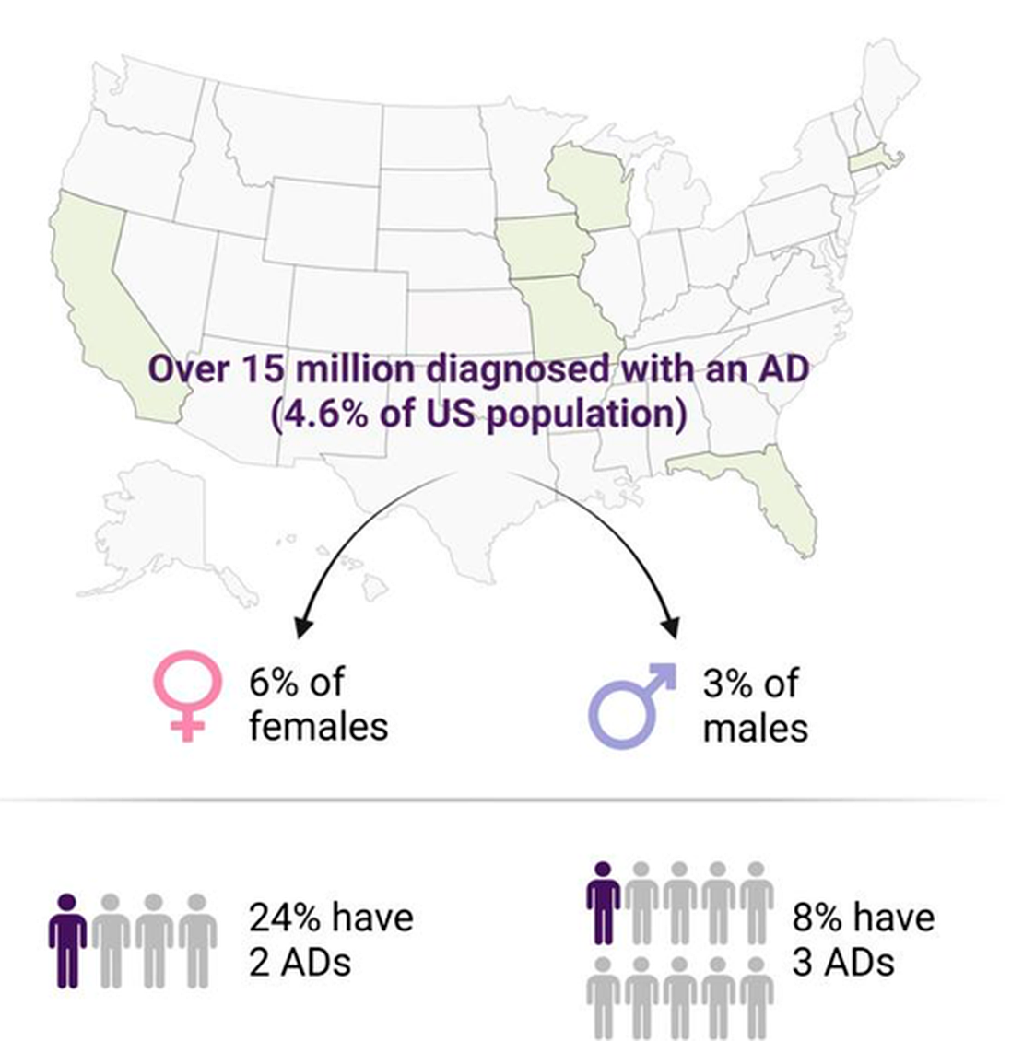
Female-predominant autoimmune diseases
Key prevalence summary
Source:
Epidemiology overview

Slide 6
Opening Case: “Low Risk” but High Risk
A 42-year-old Hispanic woman with SLE, lupus nephritis, intermittent prednisone exposure, LDL-C 105 mg/dL, no diabetes, and no smoking history presents with NSTEMI. Her calculated 10-year ASCVD risk was low.
Which factor most likely contributed to underestimation of her cardiovascular risk?
A
Female sex alone
B
LDL-C below 130 mg/dL
C
Chronic systemic inflammation and lupus-related risk
D
Absence of diabetes
References: 2019 ACC/AHA Primary Prevention Guideline; EULAR CV Risk Management Recommendations; Conrad et al., Lancet 2022.
Immunologic Diseases and Cardiovascular Risk: Beyond Traditional Risk Factors

Slide 7
Objective 2: Pathophysiology
How immune-mediated disease creates cardiovascular injury beyond traditional risk factors.
Immune
activation
Cytokines
IL-1 • IL-6 • TNF-α
Endothelial
dysfunction
Plaque
instability
Thrombosis
MI / Stroke
Accelerated atherosclerosis
Persistent inflammation promotes lipid oxidation, macrophage activation, and vulnerable plaque.
Microvascular dysfunction
Small-vessel inflammation can cause ischemia even without obstructive epicardial CAD.
Direct cardiac involvement
Myocarditis, pericarditis, valvular disease, arrhythmia, fibrosis, and PAH may occur depending on disease phenotype.
Inflammation is not a background variable — it is an active driver of vascular and myocardial injury.
References: Libby P. Nature 2021; 2019 ACC/AHA Primary Prevention Guideline; EULAR CV Risk Management Recommendations; Conrad et al., Lancet 2022.
Immunologic Diseases and Cardiovascular Risk: Beyond Traditional Risk Factors

Slide 8
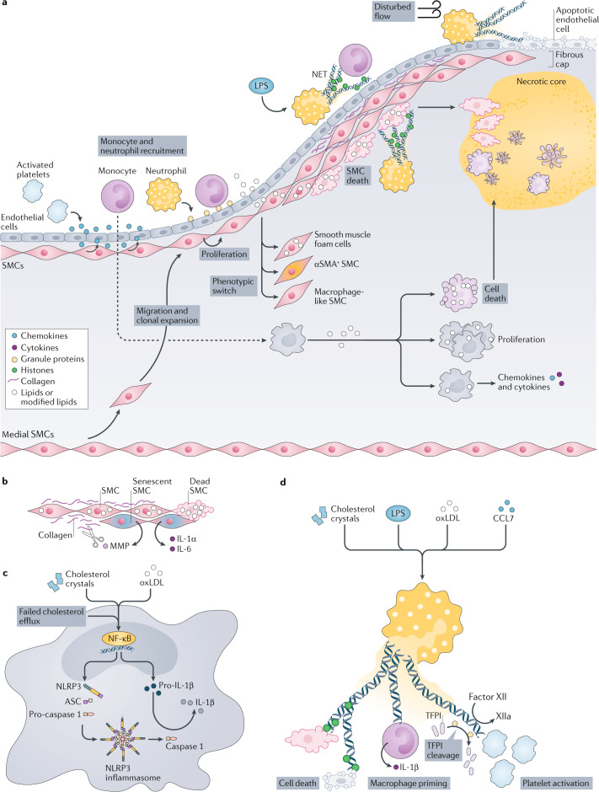

Slide 9
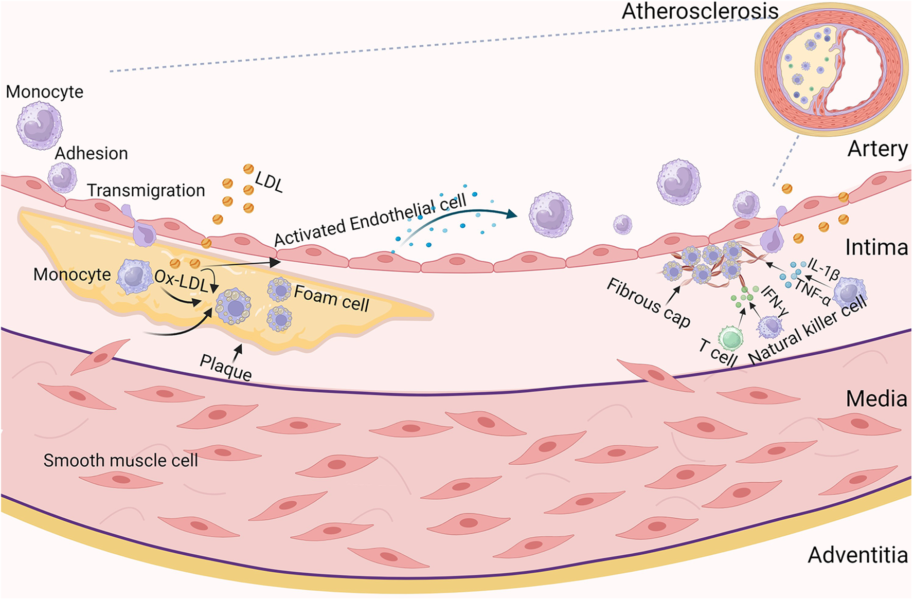

Slide 10
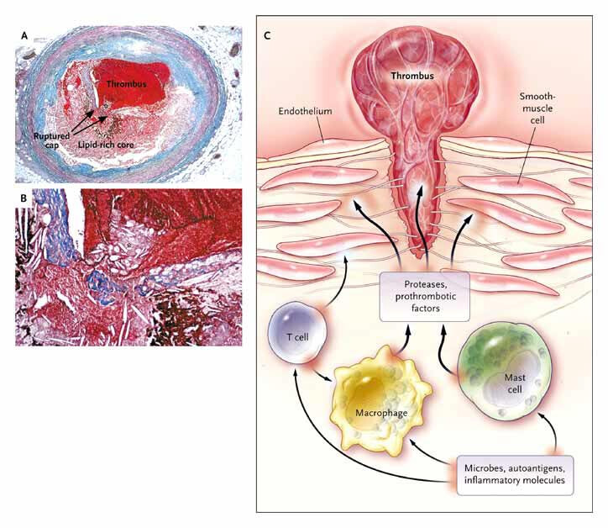
T Inflammation, Atherosclerosis, and Coronary Artery Disease, 2005, New England Journal of Medicine
doi:10.1056/NEJMra043430

Slide 11
Mechanism Map: Why the Risk Score Can Miss It
The cardiovascular phenotype depends on the disease, inflammation burden, treatment exposure, and vascular bed involved.
Inflammatory vascular injury
Thrombotic / immune-mediated injury
Treatment and organ-specific risk
Endothelial dysfunction
APS antibodies
Glucocorticoid metabolic toxicity
Oxidative stress
Platelet activation
NSAID BP/HF/renal effects
Accelerated plaque formation
Complement activation
JAK inhibitor MACE/thrombosis caution
Plaque vulnerability
Arterial or venous thrombosis
Nephritis, CKD, PAH, fibrosis
Clinical outcomes: premature ASCVD, MI, stroke, HF, myocarditis, pericarditis, PAH, arrhythmia, and thromboembolism.
References: 2019 ACC/AHA Primary Prevention Guideline; EULAR CV Risk Management Recommendations; FDA JAK inhibitor safety communication; Conrad et al., Lancet 2022.
Immunologic Diseases and Cardiovascular Risk: Beyond Traditional Risk Factors

Slide 12
Microvascular & Direct Cardiac Involvement
Microvascular ischemia
Direct cardiac involvement
• Endothelial activation and small-vessel inflammation can impair coronary flow reserve
• Symptoms may mimic angina despite nonobstructive coronaries
• Consider PET myocardial blood flow reserve, stress CMR, or invasive coronary function testing in selected patients
• Particularly relevant in SLE, systemic sclerosis, vasculitis, and inflammatory myopathies
• Pericarditis and myocarditis: SLE, RA, vasculitis, myositis, post-viral immune states
• Myocardial fibrosis and arrhythmias: systemic sclerosis, sarcoid-like inflammatory disease
• Valvular disease: APS and SLE-associated sterile valvular lesions
• Pulmonary vascular disease: systemic sclerosis and mixed connective tissue disease
Clinical message: when symptoms are out of proportion to coronary anatomy, think microvascular disease, myocarditis, fibrosis, PAH, or thrombotic disease.
References: EULAR CV risk recommendations 2022; 2024 ESC Chronic Coronary Syndromes guideline; Paulus & Tschöpe JACC 2013; Taqueti et al. Circulation 2018.
Immunologic Diseases and Cardiovascular Risk: Beyond Traditional Risk Factors

Slide 13
Mechanism Synthesis: Four Cardiovascular Phenotypes
1. Atherosclerotic
2. Thrombotic
3. Microvascular
4. Myocardial / Pulmonary vascular
Accelerated plaque formation
Plaque vulnerability
Premature MI / stroke
APS antibodies
Platelet/complement activation
Arterial and venous events
Endothelial dysfunction
Impaired flow reserve
INOCA / HFpEF phenotype
Pericarditis / myocarditis
Fibrosis / arrhythmia
PAH / RV dysfunction
The same patient may carry more than one phenotype — prevention and testing should be phenotype-driven, not disease-label driven.
Practical approach: identify phenotype → quantify traditional risk → add immune-specific risk → choose targeted testing → treat aggressively.
References: Libby Nat Rev Drug Discov 2021; EULAR CV risk recommendations 2022; 2024 ESC CCS guideline.
Immunologic Diseases and Cardiovascular Risk: Beyond Traditional Risk Factors

Slide 14
Why Inflammation Became a Therapeutic Target?
The clinical observation
The trial question
• Many patients have recurrent events despite LDL-C lowering and guideline-directed therapy
• hs-CRP identifies residual inflammatory risk in atherosclerosis
• Inflammatory pathways overlap with immune-mediated diseases: IL-1β, IL-6, TNF-α, complement, inflammasome activation
• If inflammation is causal, targeted anti-inflammatory therapy should reduce events
• Positive trials: CANTOS, COLCOT, LoDoCo2
• Negative or nuanced trials: CIRT, CLEAR SYNERGY
• Lesson: biology, dose, timing, population, and endpoint selection matter
Important nuance: anti-inflammatory benefit does not mean every immunosuppressive drug is cardioprotective.
References: Ridker NEJM 2017; Ridker NEJM 2019; Tardif NEJM 2019; Nidorf NEJM 2020; Jolly NEJM 2024 / ACC CLEAR SYNERGY summary.
Immunologic Diseases and Cardiovascular Risk: Beyond Traditional Risk Factors

Slide 15
Inflammation Trials: CANTOS vs CIRT
CANTOS — positive proof-of-concept
CIRT — negative but highly instructive
• RCT, double-blind, placebo-controlled; N = 10,061
• Population: prior MI with hs-CRP ≥2 mg/L
• Intervention: canakinumab 50/150/300 mg SC q3 months vs placebo
• Primary endpoint: nonfatal MI, nonfatal stroke, or CV death
• Biologic effect: reduced hs-CRP and IL-6 without lowering LDL-C
• Result: 150 mg dose reduced recurrent CV events; HR 0.85 (95% CI 0.74–0.98)
• Interpretation: IL-1β / IL-6 pathway is clinically relevant
• RCT, double-blind, placebo-controlled; N = 4,786
• Population: prior MI or multivessel CAD + diabetes/metabolic syndrome
• Intervention: low-dose methotrexate 15–20 mg weekly vs placebo
• Primary endpoint: nonfatal MI, nonfatal stroke, CV death, or unstable angina requiring urgent revascularization
• Biologic effect: no significant reduction in IL-1β, IL-6, or hs-CRP
• Result: no reduction in CV events; stopped early for futility
• Interpretation: not all anti-inflammatory strategies modify relevant vascular biology
Bottom line: benefit requires the right pathway, right biomarker, and right patient population.
References: Ridker et al. N Engl J Med 2017 (CANTOS); Ridker et al. N Engl J Med 2019 (CIRT).
Immunologic Diseases and Cardiovascular Risk: Beyond Traditional Risk Factors

Slide 16
Colchicine Trials: COLCOT vs LoDoCo2
COLCOT — recent MI
LoDoCo2 — chronic coronary disease
• RCT, double-blind, placebo-controlled; N = 4,745
• Population: recent MI within 30 days
• Intervention: colchicine 0.5 mg daily vs placebo
• Primary endpoint: CV death, resuscitated arrest, MI, stroke, or urgent angina-driven revascularization
• Result: primary endpoint 5.5% vs 7.1%; HR 0.77 (95% CI 0.61–0.96)
• Safety: pneumonia signal; monitor drug interactions and renal/hepatic disease
• Interpretation: post-MI inflammation may be modifiable in selected patients
• RCT, double-blind, placebo-controlled; N = 5,522
• Population: clinically stable chronic coronary disease
• Intervention: colchicine 0.5 mg daily vs placebo
• Primary endpoint: CV death, spontaneous MI, ischemic stroke, or ischemia-driven coronary revascularization
• Result: primary endpoint 6.8% vs 9.6%; HR 0.69 (95% CI 0.57–0.83)
• Safety: GI intolerance, renal function, CYP3A4/P-gp interactions
• Interpretation: inflammation targeting can extend to stable CAD
Bottom line: colchicine is not a rheumatology curiosity — it is now part of the secondary prevention conversation.
References: Tardif et al. N Engl J Med 2019 (COLCOT); Nidorf et al. N Engl J Med 2020 (LoDoCo2); ACC colchicine clinical updates 2025.
Immunologic Diseases and Cardiovascular Risk: Beyond Traditional Risk Factors

Slide 17
CLEAR SYNERGY: Why the Evidence Is Nuanced
The largest post-PCI acute MI colchicine trial did not reproduce the COLCOT result.
Feature
CLEAR SYNERGY (OASIS-9)
Design / N
International, double-blind, 2×2 factorial RCT; N = 7,062
Population
Acute MI undergoing PCI; predominantly STEMI; median follow-up 3 years
Intervention
Colchicine 0.5 mg daily vs placebo; factorial spironolactone assignment
Primary endpoint
CV death, MI, stroke, or ischemia-driven revascularization
Result
9.1% vs 9.3%; HR 0.99 (95% CI 0.85–1.16); p = 0.93
Interpretation
Routine colchicine immediately after PCI for acute MI was not beneficial in this trial
Clinical interpretation: colchicine remains biologically compelling, but timing, adherence, population, and endpoint selection matter.
References: Jolly et al. N Engl J Med 2024; ACC CLEAR SYNERGY (OASIS-9) trial summary 2024.
Immunologic Diseases and Cardiovascular Risk: Beyond Traditional Risk Factors

Slide 18
What Do These Trials Mean for Immune-Mediated Disease?
What we can say
What we should not overstate
• Inflammation is not just associated with ASCVD — targeted inhibition can modify events in selected populations
• Residual inflammatory risk can persist despite LDL-C control
• Pathway specificity matters: IL-1β/IL-6 biology and NLRP3/colchicine effects have clinical signals
• ASCVD prevention in immune disease should be earlier and more individualized
• Do not assume every immunosuppressive therapy is cardioprotective
• Do not extrapolate CANTOS/COLCOT directly to all rheumatologic populations
• Do not ignore infection risk, drug interactions, renal function, and treatment burden
• Do not let inflammation control substitute for LDL-C, BP, diabetes, smoking, and weight management
For the cardiologist: inflammation adds a prevention layer — it does not erase traditional prevention.
References: Ridker NEJM 2017; Tardif NEJM 2019; Nidorf NEJM 2020; CLEAR SYNERGY ACC summary 2024; EULAR CV risk recommendations 2022.
Immunologic Diseases and Cardiovascular Risk: Beyond Traditional Risk Factors

Slide 19
Rheumatoid Arthritis: ASCVD Risk Amplifier
CV pattern
Cardiology approach
• Accelerated atherosclerosis and higher MI/stroke risk
• Risk relates to disease activity, inflammatory markers, seropositivity, and duration
• Heart failure risk may be increased, including HFpEF-like phenotypes
• Pericarditis, nodules, vasculitis, and conduction disease are less common but clinically relevant
• Treat ASCVD score as a starting point not the final answer
• Aggressively address LDL-C, BP, diabetes, smoking, weight, sleep, and physical activity
• Ask about steroid exposure and current disease activity
• Consider statin therapy when borderline/intermediate risk is pushed upward by RA risk enhancer
• Coordinate with rheumatology to control inflammation while minimizing chronic glucocorticoids
Clinical pearl: the “borderline” RA patient is often not truly borderline.
References: 2019 ACC/AHA Primary Prevention Guideline; 2018 ACC/AHA Cholesterol Guideline; EULAR CV risk recommendations 2022.
Immunologic Diseases and Cardiovascular Risk: Beyond Traditional Risk Factors

Slide 20
Systemic Lupus Erythematosus: Premature Vascular Risk
High-risk features
What to screen
• Young women can present with MI or stroke despite low calculated 10-year risk
• Lupus nephritis and CKD amplify risk
• Antiphospholipid antibodies shift phenotype toward thrombosis
• Active disease and cumulative glucocorticoid exposure worsen metabolic risk
• Pericarditis, myocarditis, valvular disease, and pulmonary hypertension may occur
• Traditional risk factors at every prevention visit: BP, lipids, A1c, kidney function, smoking
• Disease-specific risks: nephritis, APS status, steroid dose/cumulative exposure, disease activity
• Symptoms of pericarditis/myocarditis, dyspnea, palpitations, pregnancy morbidity history
• Consider , ApoB, Lp(a), hs-CRP or imaging when risk estimate does not fit the clinical picture
Clinical pearl: in SLE, a low ASCVD score can be falsely reassuring — especially in younger women.
References: EULAR CV risk recommendations 2022; 2019 ACC/AHA Primary Prevention Guideline; ACC Expert Analysis on ASCVD prediction in SLE 2025.
Immunologic Diseases and Cardiovascular Risk: Beyond Traditional Risk Factors

Slide 21
Psoriasis & Psoriatic Arthritis: Skin as a Systemic Signal
CV pattern
Prevention strategy
• ASCVD risk increases with inflammatory burden and severe disease
• Metabolic syndrome, obesity, diabetes, hypertension, and smoking frequently cluster
• Psoriatic arthritis adds systemic inflammatory burden
• Risk is not explained by the skin alone it reflects immune-metabolic vascular inflammation
• Treat psoriasis/PsA as a risk-enhancing condition in prevention discussions
• Do not wait for very high LDL-C to discuss statins in borderline/intermediate-risk patients
• Prioritize weight, BP, A1c, lipids, smoking cessation, sleep apnea screening, and exercise
• Coordinate with dermatology/rheumatology; biologic therapy may improve inflammation but should not replace standard CV prevention
Clinical pearl: severe psoriasis is not cosmetic — it is a cardiovascular risk signal.
References: 2019 ACC/AHA Primary Prevention Guideline; 2018 ACC/AHA Cholesterol Guideline; EULAR CV risk recommendations 2022; Mehta et al. psoriasis/vascular inflammation literature.
Immunologic Diseases and Cardiovascular Risk: Beyond Traditional Risk Factors

Slide 22
Antiphospholipid Syndrome: Thrombosis, Not Just Plaque
When to suspect APS
Diagnosis requires persistence
Management implications
• Young stroke/TIA or MI with minimal plaque burden
• Recurrent venous or arterial thrombosis
• Pregnancy morbidity or recurrent pregnancy loss
• SLE, livedo reticularis, thrombocytopenia, valve lesions
• Recurrent events despite apparently appropriate therapy
• Lupus anticoagulant
• Anticardiolipin antibody
• Anti-β2 glycoprotein I antibody
• Repeat positivity ≥12 weeks apart
• Risk highest with lupus anticoagulant and triple positivity
• Coordinate with hematology/rheumatology for anticoagulation strategy
• EULAR recommends against rivaroxaban in triple-positive APS
• Arterial APS often requires a VKA-based strategy rather than casual DOAC substitution
• Still control traditional CV risks: smoking, BP, LDL-C, diabetes, estrogen exposure
Clinical pearl: APS is a mechanism diagnosis — it explains events that do not behave like typical plaque rupture.
References: EULAR APS management recommendations 2019; EULAR CV risk recommendations 2022; Miyakis et al. J Thromb Haemost 2006.
Immunologic Diseases and Cardiovascular Risk: Beyond Traditional Risk Factors

Slide 23
Systemic Sclerosis: Pulmonary Vascular & Myocardial Disease
Cardiovascular phenotype
Guideline-oriented approach
• Pulmonary arterial hypertension: major cause of morbidity and mortality
• Microvascular ischemia and impaired coronary flow reserve
• Myocardial fibrosis with diastolic dysfunction, arrhythmias, and conduction disease
• Pericardial disease and right ventricular dysfunction may occur
• Raynaud/microvascular disease reflects systemic vascular pathology
• Annual symptom review for exertional dyspnea, syncope, edema, palpitations, chest pain
• Low threshold for echocardiography, NT-proBNP, DLCO/PFT review, and referral for RHC when PAH suspected
• Use cardiac MRI when myocarditis/fibrosis is suspected
• ASCVD prevention still matters, but CAD is only one part of the risk phenotype
Clinical pearl: in systemic sclerosis, unexplained dyspnea is PAH until proven otherwise.
References: EULAR CV risk recommendations 2022; ESC/ERS pulmonary hypertension guidelines 2022; 2024 ESC CCS guideline.
Immunologic Diseases and Cardiovascular Risk: Beyond Traditional Risk Factors

Slide 24
Vasculitis: Inflammation of the Vessel Wall
Vasculitis can cause ischemia through stenosis, aneurysm, thrombosis, or direct coronary involvement.
Large-vessel disease
Small/medium-vessel disease
• Giant cell arteritis: aortitis, large-vessel stenosis, aneurysm, stroke risk
• Takayasu arteritis: young women, limb claudication, BP discrepancies, vascular bruits
• Coronary ostial disease and aortic involvement can mimic conventional CAD
• Imaging: CTA/MRA/PET-CT depending on vascular bed and disease activity
• ANCA-associated vasculitis: myocarditis, pericarditis, coronary arteritis, renal-driven risk
• Kawasaki disease history: coronary aneurysm and late coronary complications
• Behçet disease: venous/arterial thrombosis and aneurysm risk
• Inflammatory activity and glucocorticoid exposure both contribute to CV burden
Clinical pearl: vascular imaging choice should follow the disease phenotype — not a generic chest pain algorithm alone.
References: EULAR CV risk recommendations 2022; 2024 ESC CCS guideline; EULAR large-vessel vasculitis recommendations.
Immunologic Diseases and Cardiovascular Risk: Beyond Traditional Risk Factors

Slide 25
IBD & Other Immune-Mediated Diseases
IBD: key CV signals
Other immune-mediated examples
• Systemic inflammation rises during disease flares and may transiently increase arterial and venous risk
• VTE risk is clinically important, especially during hospitalization, flares, surgery, and steroid exposure
• Young patients may have low calculated ASCVD risk but high inflammatory burden
• Medication exposure, anemia, dehydration, and hospitalization modify risk
• Sarcoidosis: conduction disease, VT, cardiomyopathy, myocardial inflammation
• Myositis: myocarditis, arrhythmia, pulmonary hypertension, interstitial lung disease-related RV strain
• Sjögren/MCTD: vascular inflammation, PAH in selected phenotypes
• HIV: guideline-recognized chronic inflammatory risk enhancer
Clinical pearl: immune-mediated CV risk is dynamic — it rises during flares, hospitalizations, and high-dose steroid exposure.
References: 2019 ACC/AHA Primary Prevention Guideline; EULAR CV risk recommendations 2022; AHA scientific statements on HIV/CVD and inflammatory disease risk.
Immunologic Diseases and Cardiovascular Risk: Beyond Traditional Risk Factors

Slide 26
Disease-Specific Cardiovascular Patterns
Disease
Dominant CV concern
High-yield clinical clue
Suggested cardiology action
RA
Accelerated ASCVD / HF
Active disease, steroids, elevated CRP
Earlier statin discussion; minimize steroids
SLE
Premature MI/stroke, nephritis, pericarditis
Young woman with event despite low risk score
Assess nephritis/APS/steroids; refine risk
Psoriasis/PsA
ASCVD + metabolic syndrome
Severe skin disease or arthritis
Treat as risk enhancer; aggressive prevention
APS
Arterial/venous thrombosis
Stroke/MI with minimal plaque; pregnancy loss
Confirm antibodies; anticoagulation expertise
Systemic sclerosis
PAH, fibrosis, microvascular disease
Dyspnea + low DLCO / high RVSP
Echo/NT-proBNP/PFT; consider RHC
Vasculitis
Vessel-wall inflammation/aneurysm/stenosis
Bruits, BP asymmetry, young vascular events
CTA/MRA/PET guided by phenotype
IBD
VTE + flare-related ASCVD risk
Hospitalized flare/steroids
VTE prevention; optimize risk factors
The disease label tells you where to look — the phenotype tells you what to do.
References: 2019 ACC/AHA Primary Prevention Guideline; EULAR CV risk recommendations 2022; ESC/ERS PH guideline 2022; EULAR APS recommendations 2019.
Immunologic Diseases and Cardiovascular Risk: Beyond Traditional Risk Factors

Slide 27
Case Question: Borderline Score, High Inflammatory Burden
A 58-year-old woman with rheumatoid arthritis has LDL-C 128 mg/dL and a 10-year ASCVD risk of 6%. She has active disease, elevated CRP, and several prednisone bursts this year.
Best next step?
A
Reassure her that no preventive therapy is needed because ASCVD risk is <7.5%
B
Consider RA a risk-enhancing condition and discuss moderate-intensity statin therapy
C
Start anticoagulation because RA causes primarily thrombotic events
D
Avoid statins because they worsen inflammatory arthritis
References: 2019 ACC/AHA Primary Prevention Guideline; 2018 ACC/AHA Cholesterol Guideline.
Immunologic Diseases and Cardiovascular Risk: Beyond Traditional Risk Factors

Slide 28
Immunologic Therapies: Steroids & NSAIDs
Glucocorticoids
NSAIDs
• Dose- and duration-dependent risk signal
• Increase BP, glucose, weight, visceral adiposity, dyslipidemia, and infection risk
• May increase thrombotic risk and worsen fluid retention
• Often necessary for flares but cumulative exposure should be treated as a CV risk marker
• Ask explicitly: current dose, bursts/year, cumulative exposure, steroid-sparing plan
• Can increase BP and worsen renal function
• Can precipitate/worsen HF and edema
• Interaction with antiplatelet therapy and GI bleeding risk matters
• Risk varies by drug, dose, and patient phenotype
• Avoid casual chronic use in HF, CKD, uncontrolled HTN, high ASCVD risk, and anticoagulated patients
Clinical pearl: the medication history is part of the cardiovascular risk assessment.
References: EULAR CV risk recommendations 2022; FDA NSAID safety communications; AHA statements on NSAIDs/CV risk; 2019 ACC/AHA Primary Prevention Guideline.
Immunologic Diseases and Cardiovascular Risk: Beyond Traditional Risk Factors

Slide 29
Methotrexate & Hydroxychloroquine
Methotrexate
Hydroxychloroquine
• Cornerstone therapy for RA and inflammatory arthritis
• Observational RA data suggested potential CV benefit through inflammation control
• CIRT tested low-dose methotrexate in CAD + DM/metabolic syndrome and was negative
• CIRT did not lower IL-1β, IL-6, or hs-CRP pathway and population matter
• Cardiology message: disease control may help, but do not cite MTX as proven ASCVD therapy
• Common in SLE and inflammatory arthritis
• May have favorable metabolic effects in selected patients
• Potential QT prolongation and rare cardiomyopathy/retinopathy require awareness
• Use caution with other QT-prolonging drugs, electrolyte abnormalities, and conduction disease
• Cardiology message: know the drug, but avoid overcalling routine CV toxicity
Clinical pearl: improved immune control may reduce risk, but randomized CV outcome data are drug- and pathway-specific.
References: Ridker et al. NEJM 2019 (CIRT); EULAR CV risk recommendations 2022; ACR/EULAR SLE and RA treatment guidance; FDA hydroxychloroquine safety information.
Immunologic Diseases and Cardiovascular Risk: Beyond Traditional Risk Factors

Slide 30
Biologics: Cardiovascular Effects Depend on Context
Class
Potential CV relevance
Clinical caution
TNF inhibitors
May lower systemic inflammation; observational data suggest lower CV event rates in responders
Avoid/warn in moderate-to-severe HF; infection risk
IL-6 pathway agents
Mechanistically linked to atherosclerotic inflammation; lipid levels may rise as inflammation falls
Interpret lipid changes in context; monitor infection risk
IL-17 / IL-23 inhibitors
Used in psoriasis/PsA; reduce inflammatory skin/joint burden
CV outcome data not equivalent to ASCVD prevention trials
B-cell / complement therapies
Relevant for severe SLE/vasculitis and selected immune phenotypes
Infection risk; disease-specific indications drive use
Take-home
Effective disease control can support prevention but does not replace standard ASCVD risk reduction
Coordinate medication decisions with rheumatology/dermatology/immunology
Cardiology role: understand CV implications, screen risk, and communicate when the patient has HF, ASCVD, VTE risk, QT issues, or severe CKD.
References: EULAR CV risk recommendations 2022; FDA biologic safety labels; CANTOS/ZEUS IL-1β–IL-6 inflammatory pathway literature.
Immunologic Diseases and Cardiovascular Risk: Beyond Traditional Risk Factors

Slide 31
JAK Inhibitors: MACE & Thrombosis Caution
JAK inhibitors are effective immunomodulators but require deliberate cardiovascular risk assessment.
What changed
Cardiology checklist before/while on therapy
• FDA required boxed warnings for certain JAK inhibitors after a large randomized safety trial
• Warnings include serious heart-related events, cancer, blood clots, and death
• Risk was compared against TNF blockers in RA patients with CV risk factors
• Clinical concern is highest in older patients and those with ASCVD, smoking history, malignancy risk, or VTE risk
• Document ASCVD, prior MI/stroke, PAD, HF, VTE, smoking, diabetes, CKD, hypertension
• Review lipids before and after initiation; intensify prevention as appropriate
• Ask about VTE symptoms and arterial symptoms at follow-up
• Avoid reflex discontinuation coordinate risk/benefit with treating specialist
• Use the warning as a prompt for prevention, not panic
Clinical pearl: JAK inhibitors should trigger a cardiovascular risk conversation before the first prescription, not after the first event.
References: FDA Drug Safety Communication on JAK inhibitors 2021/2022; ORAL Surveillance literature; EULAR CV risk recommendations 2022.
Immunologic Diseases and Cardiovascular Risk: Beyond Traditional Risk Factors

Slide 32
Medication Effects: Cardiovascular Risk Lens
Therapy
Potential CV downside
Potential CV upside
Cardiology action
Glucocorticoids
HTN, diabetes, weight, lipids, thrombosis, HF
Rapid disease control in flares
Minimize chronic dose; intensify prevention
NSAIDs
BP, kidney injury, HF, bleeding/antiplatelet issues
Symptom control; steroid-sparing sometimes
Avoid chronic use in HF/CKD/high risk
Methotrexate
Hepatic/renal monitoring; not proven as CV prevention
Inflammation control in RA
Do not extrapolate CIRT incorrectly
Hydroxychloroquine
QT/drug interactions; rare cardiomyopathy
Metabolic effects; SLE disease control
ECG/QT awareness in high-risk settings
Biologics
Infection; class-specific cautions
May reduce inflammatory burden
Coordinate by disease + CV phenotype
JAK inhibitors
MACE/VTE warning in higher-risk patients
Effective immune control
Risk-stratify before and during therapy
Medication history is not background information — it is a cardiovascular risk modifier.
References: EULAR CV risk recommendations 2022; FDA JAK inhibitor safety communication; Ridker NEJM 2019; AHA/ACC prevention guidance.
Immunologic Diseases and Cardiovascular Risk: Beyond Traditional Risk Factors

Slide 33
ACC/AHA Prevention Lens: Risk Enhancers
Guidelines support moving beyond the calculated score when chronic inflammation is present.
Risk enhancers include
How to use them
• Chronic inflammatory conditions: rheumatoid arthritis, psoriasis, lupus, HIV
• Family history of premature ASCVD
• CKD, metabolic syndrome, premature menopause, pregnancy-associated conditions
• Persistently elevated triglycerides
• Selected biomarkers: hs-CRP, Lp(a), ApoB, ABI
• For borderline/intermediate risk: risk enhancers can favor statin initiation or intensification
• Use clinician patient discussion rather than score-only decision-making
• If uncertainty remains, CAC scoring can refine risk in appropriate patients
• In immune disease, active inflammation and steroid exposure should raise concern even when LDL-C looks “acceptable”
Guideline translation: immune-mediated disease is a reason to look harder — not a reason to ignore the score.
References: 2019 ACC/AHA Primary Prevention Guideline; 2018 ACC/AHA Multisociety Cholesterol Guideline.
Immunologic Diseases and Cardiovascular Risk: Beyond Traditional Risk Factors

Slide 34
ASCVD Score Limitations: How to Refine Risk
Traditional calculators can underestimate risk in young women and immune-mediated disease.
Why the score can miss risk
Risk refinement tools
• Age drives 10-year risk; younger patients may appear falsely low risk
• Sex differences may obscure premature events in women with SLE/RA
• Inflammatory burden, nephritis, APS antibodies, and steroid exposure are not fully captured
• Risk is dynamic: flares, hospitalizations, and therapy changes matter
• CAC score when statin decision remains uncertain
• ApoB when atherogenic particle burden is suspected
• Lp(a) especially with family history/premature ASCVD
• hs-CRP as residual inflammatory risk marker, interpreted in disease context
• Carotid plaque or vascular imaging in selected rheumatic disease phenotypes
Clinical pearl: use CAC and biomarkers to clarify risk — not to delay prevention in obviously high-risk inflammatory disease.
References: 2019 ACC/AHA Primary Prevention Guideline; 2018 ACC/AHA Cholesterol Guideline; 2024 ESC CCS guideline; EULAR CV risk recommendations 2022.
Immunologic Diseases and Cardiovascular Risk: Beyond Traditional Risk Factors

Slide 35
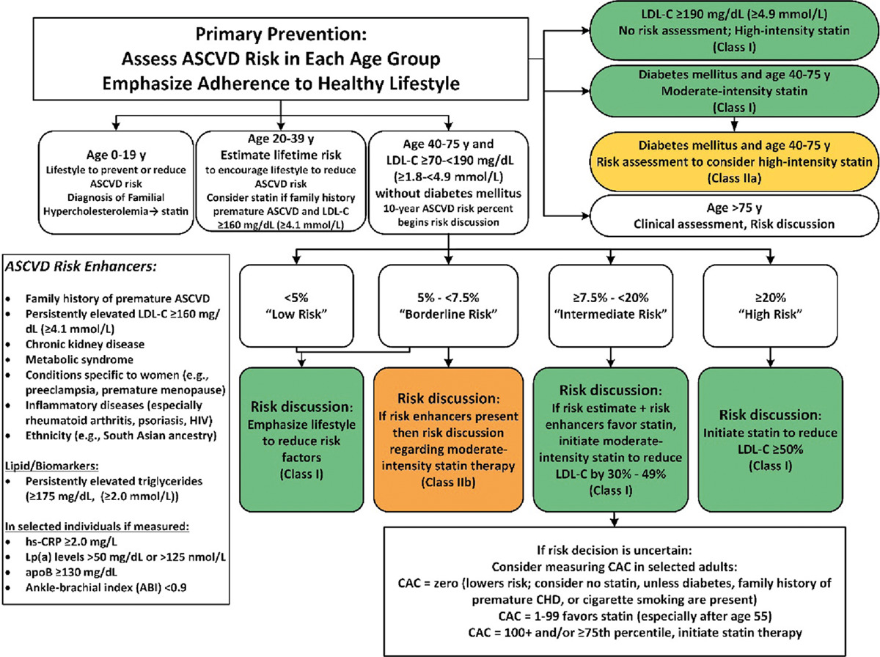
2019 ACC/AHA Guideline on the Primary Prevention of Cardiovascular Disease: A Report of the American College of Cardiology/American Heart Association Task Force on Clinical Practice Guidelines

Slide 36
EULAR Recommendations: CV Risk Management in RMDs
Overarching principles
Practical recommendations for cardiology
• Clinicians should be aware of increased CV risk across rheumatic and musculoskeletal diseases
• Management requires coordination between rheumatology, primary care, cardiology, and other specialists
• Disease activity and inflammation should be controlled alongside traditional CV risk factors
• Lifestyle and conventional risk factor management remain foundational
• Screen BP, lipids, diabetes, smoking, CKD, obesity, and physical activity regularly
• Recognize disease-specific risk: SLE nephritis, APS thrombosis, SSc PAH, vasculitis vessel involvement
• Minimize chronic glucocorticoid exposure when feasible through coordinated care
• Use guideline-based prevention, adapted to the inflammatory phenotype and patient preference
EULAR message: cardiovascular prevention is part of inflammatory disease management — not an optional add-on.
References: Drosos et al. Ann Rheum Dis 2022: EULAR CV risk management recommendations; EULAR APS recommendations 2019.
Immunologic Diseases and Cardiovascular Risk: Beyond Traditional Risk Factors

Slide 37
Practical Cardiology Algorithm
1
Identify immune disease phenotype
RA/SLE/PsA/APS/SSc/vasculitis/IBD; active vs controlled; organ involvement
2
Quantify traditional risk
BP, LDL-C/non-HDL-C, A1c, smoking, CKD, obesity, family history, pregnancy history
3
Add immune-specific modifiers
Flares, hs-CRP, nephritis, APS antibodies, steroid exposure, JAK inhibitor use, PAH/fibrosis
4
Refine risk when needed
CAC, ApoB, Lp(a), hs-CRP, echo, CMR, PET flow reserve, CTA/MRA depending on phenotype
5
Treat and coordinate
Statins/BP/diabetes/smoking/weight + steroid-sparing disease control + shared care model
Goal: prevent the event before the angiogram — and before the “low-risk” patient declares themselves high risk.
References: 2019 ACC/AHA Primary Prevention Guideline; 2018 ACC/AHA Cholesterol Guideline; EULAR CV risk recommendations 2022; 2024 ESC CCS guideline.
Immunologic Diseases and Cardiovascular Risk: Beyond Traditional Risk Factors

Slide 38
Current Trials & Future Directions
Ongoing / evolving trials
Future clinical model
• ZEUS: ziltivekimab vs placebo in ASCVD + CKD + hs-CRP ≥2 mg/L; tests IL-6 inhibition for CV outcomes
• ARTEMIS: ziltivekimab after acute MI; tests whether IL-6 inhibition reduces future events
• HERMES / ATHENA: ziltivekimab in HFpEF/HFmrEF with systemic inflammation
• ZEPHYR and imaging studies: plaque biology, inflammation, and vascular remodeling endpoints
• CLEAR SYNERGY reminds us that not every anti-inflammatory strategy will translate into event reduction
• Phenotype-guided prevention: atherosclerotic, thrombotic, microvascular, myocardial/pulmonary vascular
• Biomarker-guided therapy: hs-CRP, IL-6 pathway, ApoB, Lp(a), renal/inflammatory markers
• Imaging-guided risk: CAC, CTA plaque, PET flow reserve, CMR fibrosis/myocarditis, vascular PET/MRA
• Cardio-rheumatology / cardio-immunology clinics for high-risk patients
• Goal: match the patient to the pathway, not just the guideline category
Future represents precision prevention: controlling LDL-C and BP while identifying the inflammatory pathway that still drives risk.
References: ClinicalTrials.gov NCT05021835 (ZEUS), NCT06118281 (ARTEMIS), NCT05636176 (HERMES); Ridker et al. JAMA Cardiol 2025 ZEUS rationale; ACC CLEAR SYNERGY summary 2024.
Immunologic Diseases and Cardiovascular Risk: Beyond Traditional Risk Factors

Slide 39

Key Guidelines & References
Scan the QR code or use the links below for the main sources used in this presentation.
1. 2019 ACC/AHA Primary Prevention Guideline
https://www.ahajournals.org/doi/10.1161/CIR.0000000000000678
2. 2018 ACC/AHA Cholesterol Guideline
https://www.ahajournals.org/doi/10.1161/CIR.0000000000000625
3. 2022 EULAR CV Risk Management Recommendations
https://ard.bmj.com/content/81/6/768
4. 2021 ESC CVD Prevention Guideline
https://academic.oup.com/eurheartj/article/42/34/3227/6358713
5. 2024 ESC Chronic Coronary Syndromes Guideline
https://www.escardio.org/Guidelines/Clinical-Practice-Guidelines/Chronic-Coronary-Syndromes
6. Conrad et al. Autoimmune Diseases and Cardiovascular Risk. Lancet 2022
https://www.thelancet.com/journals/lancet/article/PIIS0140-6736(22)01349-6/abstract
7. CDC Heart Disease Facts
https://www.cdc.gov/heart-disease/data-research/facts-stats/index.html
Scan for links
This QR code contains the same resource list shown on this slide.
Immunologic Diseases and Cardiovascular Risk: Beyond Traditional Risk Factors

